Slide 1


Application of the SomaLogic Targeted Proteomics Platform for Profiling Human Patient and Murine Plasma Specimens
Matthew Chang, Sophia Soriano, Mark R. Flory, Jessie May Cartier, Aaron Grossberg, Ryan Kopp
Facilitator: James McGann
February 9, 2024
CEDAR Project Milestone presentation

Slide 2
The Problem: While SomaScan has several apparent advantages, we do not know how well this aptamer-based targeted proteomics platform performs nor how its outputs correspond to those from MS
Targeted proteomic approaches, while typically highly sensitive and easy to perform, have historically lacked sufficient numbers of panel targets
Mass spectrometry-based blood proteomics often requires sample volumes precluding some input type, for example intra-murine longitudinal samples
It is not clear how outputs from affinity reagent-based targeted proteomic platforms will compare to those relying on discovery-mode mass spectrometry
Our Potential Solution
The SomaScan targeted proteomics platform enables the ability to survey over 7000 protein targets in plasma and serum
We will test on a limited basis the performance of SomaScan on human and murine specimens to (a) assess data outputs and quality overall and (b) compare SomaScan outputs to those from Seer/MS
It is critical we understand different proteomic platforms and what they each provide so we can most efficiently deploy them for different individual study needs

Slide 3
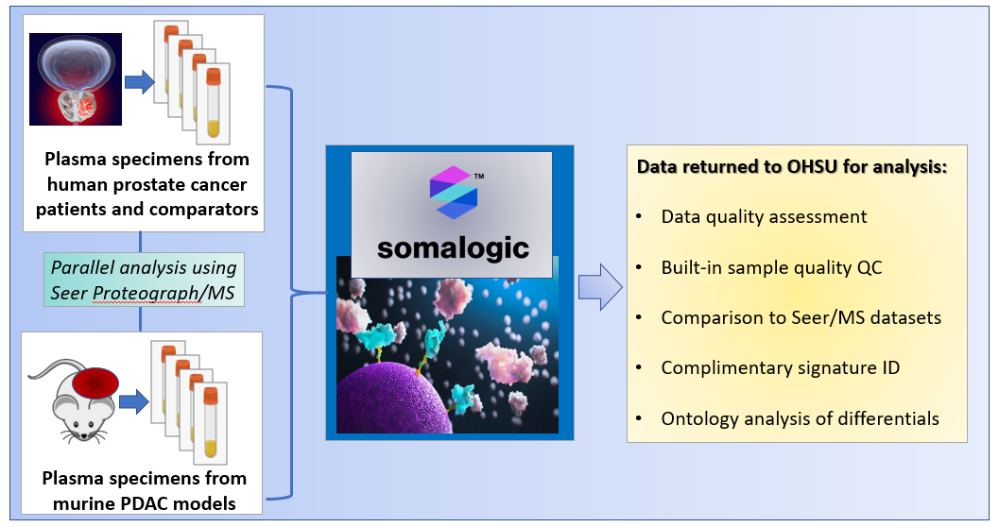
Overview of This Project in Quad Chart Format

Slide 4
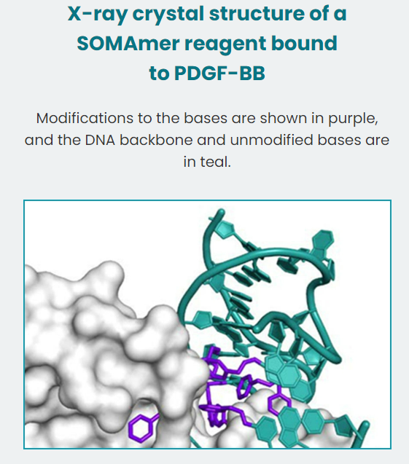
The SOMAmer Aptamer Reagent
SOMAmer: Slow Off-Rate Modified Aptamer
DNA with hydrophobic functional groups for shape matching
Slow off rates to enable vigorous washing
Polyanionic competitors to reduce non-specific interactions
7000 targets now, soon 10,000 (Q4, 2023)
Originally designed for human targets, expanded to mouse
Main usage now is for plasma and serum
Not clear how many proteoforms are targeted
Some trust required on reagent specificity

Slide 5
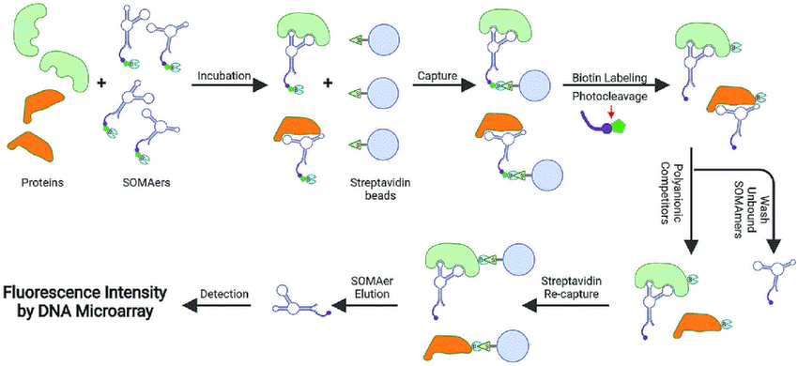
The SomaScan Platform Workflow (Typically Plasma or Serum as Input Material)
Incubation
Capture
Biotin Labeling
Photocleavage
Proteins
SOMAmers
Streptavidin Beads
Polyanionic
competitors
Wash away unbound SOMAmers
Fluorescence intensity by microarray
and coming soon
NGS-based readout
SOMAmer
Elution
Streptavidin
re-capture
Detection

Slide 6
The SomaScan Platform Workflow (Typically Plasma or Serum as Input Material)
Two capture points increases specificity
1
Incubation
Capture
Biotin Labeling
Photocleavage
Proteins
SOMAmers
Streptavidin Beads
Polyanionic
competitors
Wash away unbound SOMAmers
2
Fluorescence intensity by microarray
and coming soon
NGS-based readout
SOMAmer
Elution
Streptavidin
re-capture
Detection
And multiple built-in quality control measures, please see slide in Appendices

Slide 7
Overview of Milestones – Interval 1
progress
 | Interval
Aims | 6 months | 12
Aim 1: Send human and murine plasma samples to SomaLogic for analysis on their SomaScan assay platform (using the full 7000-target panel) and receive output data back from SomaLogic for all samples submitted. | Milestone 1: Receive data back from SomaLogic within 3 months of sending specimens to their facility in Colorado.
Aim 2: Perform initial data analysis on human plasma specimens, including assessment of technical assay reproducibility, level of consistency between human patient specimens, and the degree to which pre-analytic specimen characteristics (e.g. pink/red color) correlate with built-in SomaScan targeted quality-control (QC) measurements of hemoglobin and haptoglobin. Determine number of detected proteins common and unique to full-volume and reduced volume/diluted pool samples. | Milestone 2: Values calculated for technical assay variance, biological variance, and power estimation. Correlation assessing relationship between pink/red specimen color and SomaScan measurement of hemoglobin/haptoglobin. Number of detected proteins common and unique to full- and reduced-volume pooled plasma specimens.

Slide 8
Overview of Milestones – Interval 2
progress
 | Interval
Aims | 6 | 12 months
Aim 3: Employ Seer Proteograph and timsTOF mass spectrometry (PG/MS) to respectively prepare and analyze 250 ul aliquots of the same murine plasma specimens and of 30 of the same human plasma specimens (2 human samples cannot be prepared due to low volume) submitted for SomaScan (human plasma PG/MS analysis to be done in this project) in order to compare platform outputs. |  | Milestone 3: At least 300 ng peptide per nanoparticle enrichment from Proteograph preparation and at least 800 protein groups identified and quantified per specimen from timsTOF mass spectrometry analysis.
Aim 4: Determine number of common proteins measured by both SomaScan and PG/MS platforms across individual patient specimens. Determine differentially expressed proteins across high- and low-grade prostate cancer specimens (15 versus 15). For differentially detected proteins measured by SomaScan and PG/MS, perform statistical analysis to assess the degree of agreement |  | Milestone 4: Number of measured proteins common and unique to SomaScan and PG/MS platform assays. Determination of differentially expressed proteins as measured by SomaScan across high- and low-grade human prostate cancer plasma specimens. Values calculated indicating degree of agreement between quantitative outputs from SomaScan and PG/MS for differentially detected proteins.
Aim 5: In preparation for murine specimen data analysis proposed for Interval 3, learn from SomaLogic internal testing how many and which of the 7000 SomaScan assay targets should/can be assessed in murine plasma samples. |  | Milestone 5: Obtain list of targets as determined by SomaLogic internal testing that can be measured in murine plasma samples.
(used already acquired Seer Pilot Project data)

Slide 9
Overview of Milestones – Interval 3
progress
 | Interval
Aims | 6 | 12 months
Aim 6: Repeat analytics described above now for murine specimens. |  | Milestone 6: Values calculated for technical assay variance, biological variance, and power estimation for murine plasma specimens. Correlation calculation assessing relationship between pink/red specimen color and SomaScan measurement of hemoglobin/haptoglobin for murine specimens. Number of detected proteins common and unique to full- and reduced volume pooled murine plasma specimens. Number of measured proteins both common and unique to the SomaScan and PG/MS platforms across individual murine plasma specimens. Determination of differentially expressed proteins in murine plasma specimens as measured by SomaScan across a subset of study arm comparisons as described in CEDAR Full Project 2021-1314.
Aim 7: Compare quantitative agreement between two assay platforms for human and for murine specimen inputs. |  | Milestone 7: Number of measured proteins common and unique to both platform assays for both human and murine specimens. Overall, between platform agreement for proteins differentially detected by the two platform assays for both human and murine specimens. Determination of whether platform agreement is similar for human and murine specimens, which would provide support for valid cross-reactivity in the murine plasma context.

Slide 10

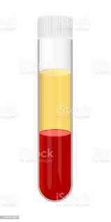
Sample Recap
Sample datasets returned well before expected date of 3 months after sample submission
Murine plasma specimens (subset of those used for murine Seer PDAC study in progress)
70 individual specimens, from various study arms
2 samples with presumed hemoloysis based on color, NOT analyzed in house
Pooled plasma from 65 specimens
3 replicates, each 55 ul “neat” pooled plasma
3 replicates, each 35 ul diluted to 55 ul using PBS
3 replicates, each with 35 ul and NOT diluted
Excellent speed on return of datasets from SomaLogic; Strategic Sample Selection
Notes:
Overview of the murine samples from the original Seer MS study submitted to SomaLogic
70 samples from various arms of the original Seer study
2 samples with presumed hemolysis contamination based on color
Another ”dilution set” of samples with plasma pooled from 65 of these samples.

Slide 11

Sample Recap
Sample datasets returned well before expected date of 3 months after sample submission
Human plasma specimens (subset of those used for Pilot Seer analysis during platform testing)
30 individual specimens, mixture of prostate cancer and comparators
Pooled plasma from 23 specimens
3 replicates, each 55 ul pooled plasma
3 replicates, each 35 ul diluted to 55 ul using PBS
3 replicates, each with 35 ul and NOT diluted
Excellent speed on return of datasets from SomaLogic; Strategic Sample Selection
Notes:
Overview of the human samples from the original Seer MS study submitted to SomaLogic
30 patient samples evenly spit between prostate cancer (case) and control
Additionally, plasma pooled from 23 of these samples was used to create a “dilution set”: 3 replicates of 55µL plasma (typical submission volume), 3 replicates of 35µL plasma diluted w/ PBS to 55µL, and 3 replicates of 35µL plasma (low volume).

Slide 12
Milestone 2 Recap: Initial data analysis on SomaLogic outputs
SomaLogic Analysis Workflow
Raw
SomaLogic Data
SomaLogic
vs.
Seer MS
Comparison
eLoD Noise Filter
QC Analysis
(Aptamers & Samples)
DE Analysis
Notes:
This diagram provides an overview of the analysis workflow used to process the murine and human data from the SomaLogic assay.
The raw data is first processed using a internally developed eLoD-based noise filter to remove intensity results below background fluorescence threshold.
The filtered data is then analyzed for assay quality, assessing the performance of the assay aptamers across samples.
After this, differential expression (DE) analyses can be performed comparing protein intensities across conditions.
Finally, the results of these SomaLogic analyses can be compared to those from the Seer Proteograph MS analysis.
NEXT

Slide 13
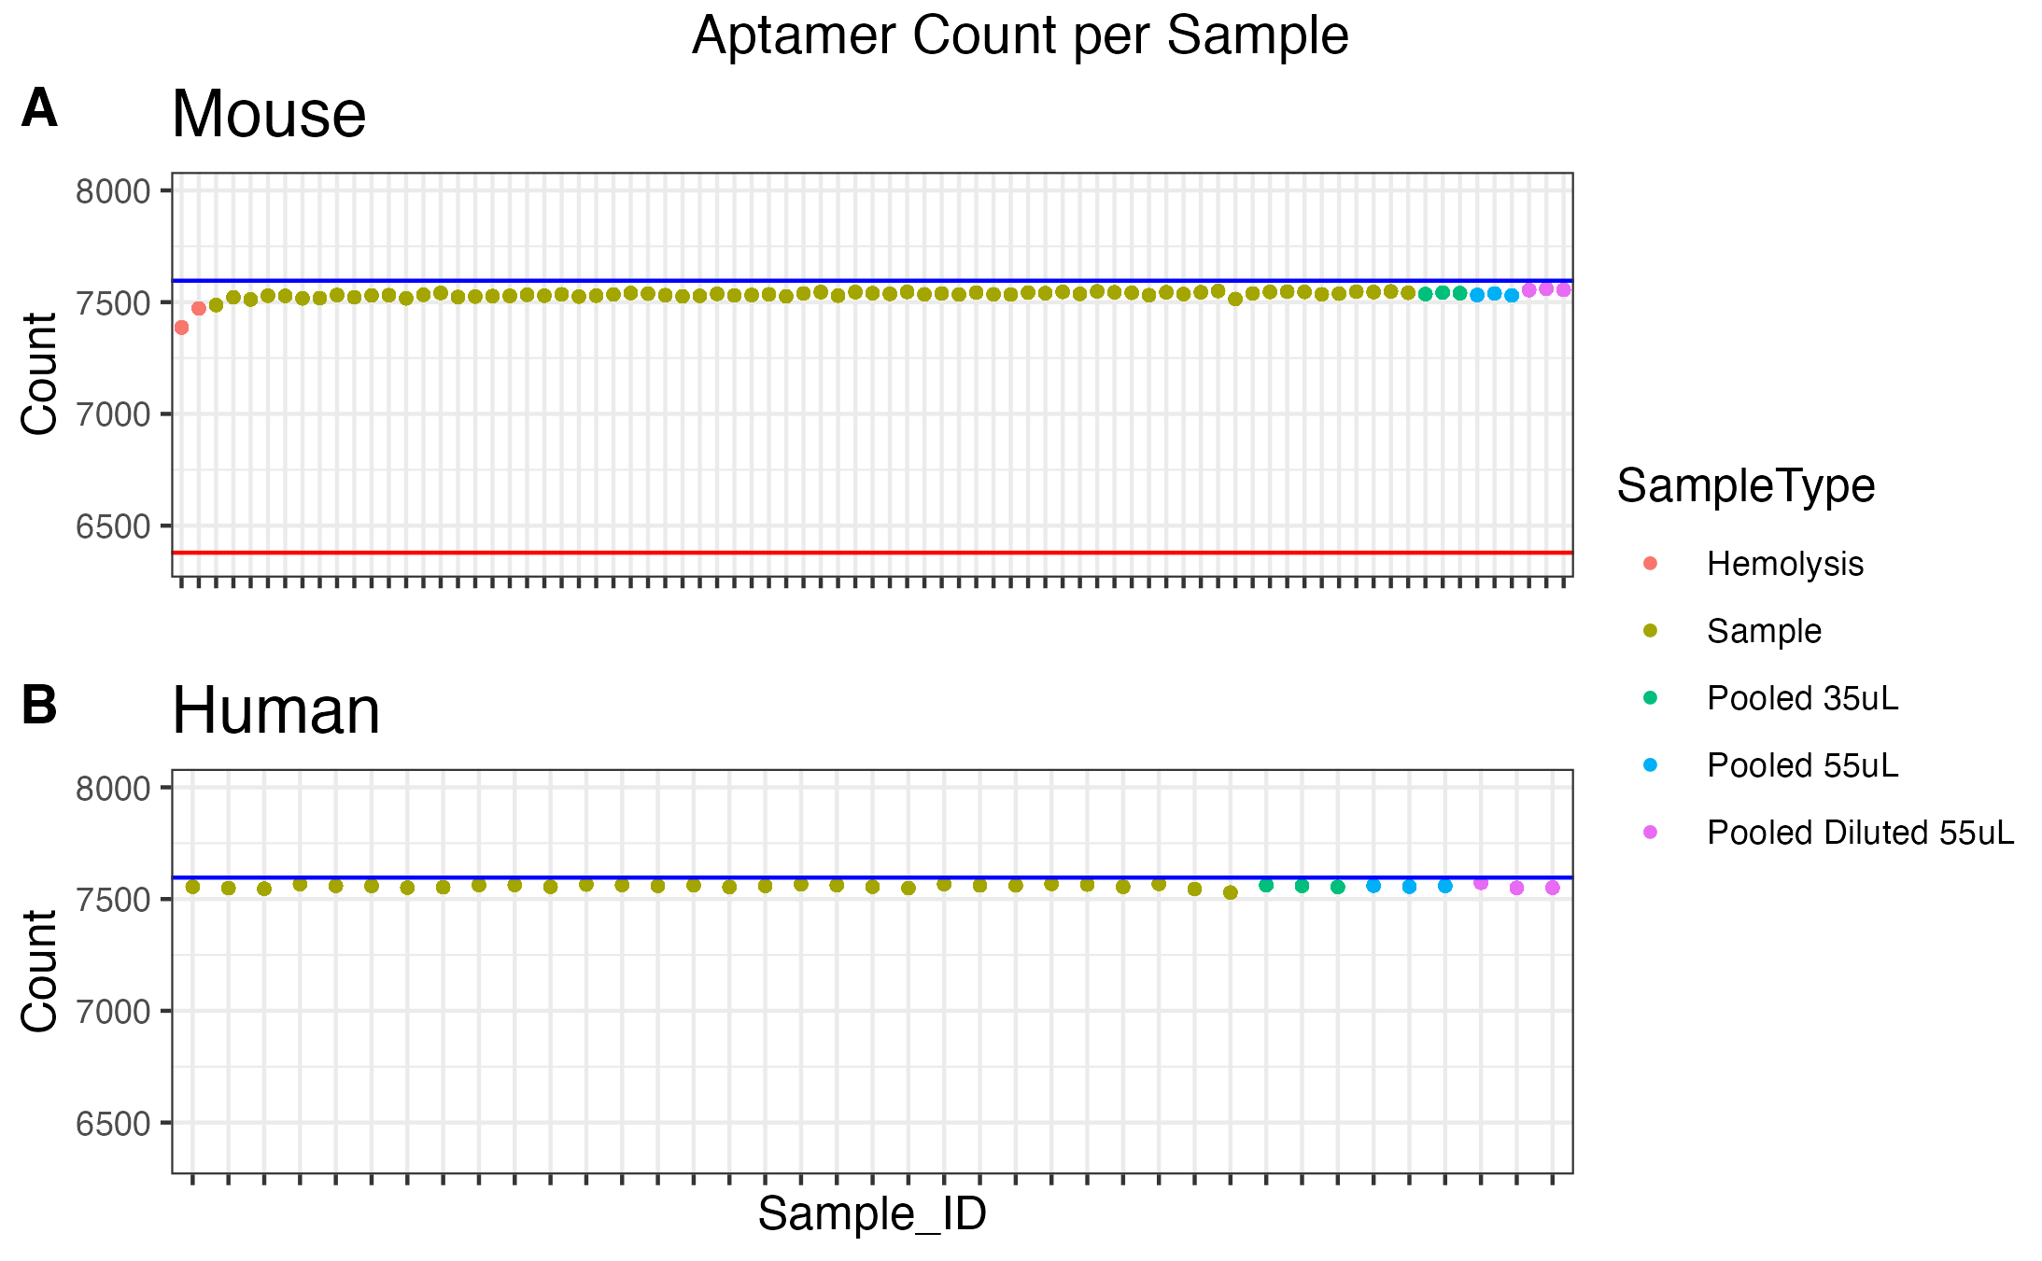
Milestone 2/6 Recap: Protein ID Counts Across Samples
Consistent, High Number of Protein IDs Across Samples
Notes:
QUESTION: One of the first QC analyses we performed was to determine the number of proteins above noise level for each sample in order to assess the aptamer assay performance on sample-by-sample basis.
ANSWER: A) Shows the number of significant aptamers detected in each of 81 murine samples, B) same across 39 human samples.
Blue line on each plot marks the total number of aptamers in the assay, 7596
Red line on the mouse plot shows the number of aptamers with expected good performance in murine studies according to SomaLogic
In both species datasets, a consistently high number of protein IDs are detected across all samples
A couple key points:
NEXT

Slide 14
Milestone 2/6 Recap: Protein ID Counts Across Samples
Consistent, High Number of Protein IDs Across Samples
Notes:
QUESTION: Regarding the ability of the Somalogic assay to detect samples with suspected hemolysis (pink/red). How do pink/red hemolysis samples compare to other samples in the dataset?
ANSWER: The two pink/red suspected hemolysis samples – marked by the red arrow – have slightly lower aptamer counts, implying fewer aptamers with significant intensity signal in these samples.
Also:
NEXT

Slide 15
Milestone 2/6 Recap: Protein ID Counts Across Samples
Consistent, High Number of Protein IDs Across Samples
Notes:
QUESTION: Another facet of this study focuses on evaluating feasibility of a smaller sample volume, in order to minimize the amount of plasma needed from murine sample collection.
ANSWER: The dilution series pooled samples – low volume 35uL, typical 55uL, and low volume diluted to 55uL – are marked by the red brackets on both plots. No differences in aptamer count are apparent across either dilution series, potentially supporting the validity of these low volume samples.
NEXT

Slide 16
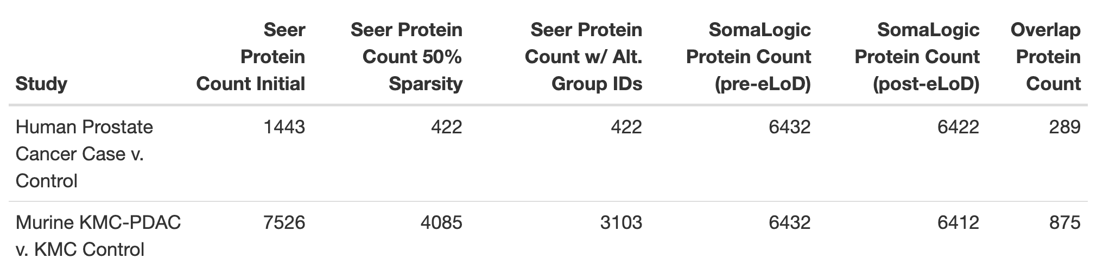
Milestone 2/6 Recap: Protein ID Counts Across Samples
Consistent, High Number of Protein IDs Across Samples, Low Overlap
Notes:
Table showing protein ID counts for each platform and various stages in the analysis.
For the murine data:
Seer initial count of valid IDs was 7526.
After the 50% sparsity filter by condition (KMC-PDAC/KMC Control) this is reduced to 4085.
Because Seer can identify protein group IDs (IDs with >1 UniProt ID) and SomaLogic does not, any protein group IDs were altered to only use the first UniProt ID in the group – this reduced the murine protein ID count to 3103 unique IDs.
Somalogic initial count was 6432 protein IDs, reduced to 6412 IDs after the eLoD filter.
Murine: 875 IDs overlap btwn platforms
For the human data:
Seer initial count of valid IDs was 1443.
After the 50% sparsity filter by condition (Case/Control) this is reduced to 422. This count did not change after the protein group alteration was applied.
Somalogic initial count 6432 protein IDs, reduced to 6422 after the eLoD filter.
Human: 289 IDs overlap btwn platforms
[Only briefly mention overlap method if necessary]
NEXT

Slide 17
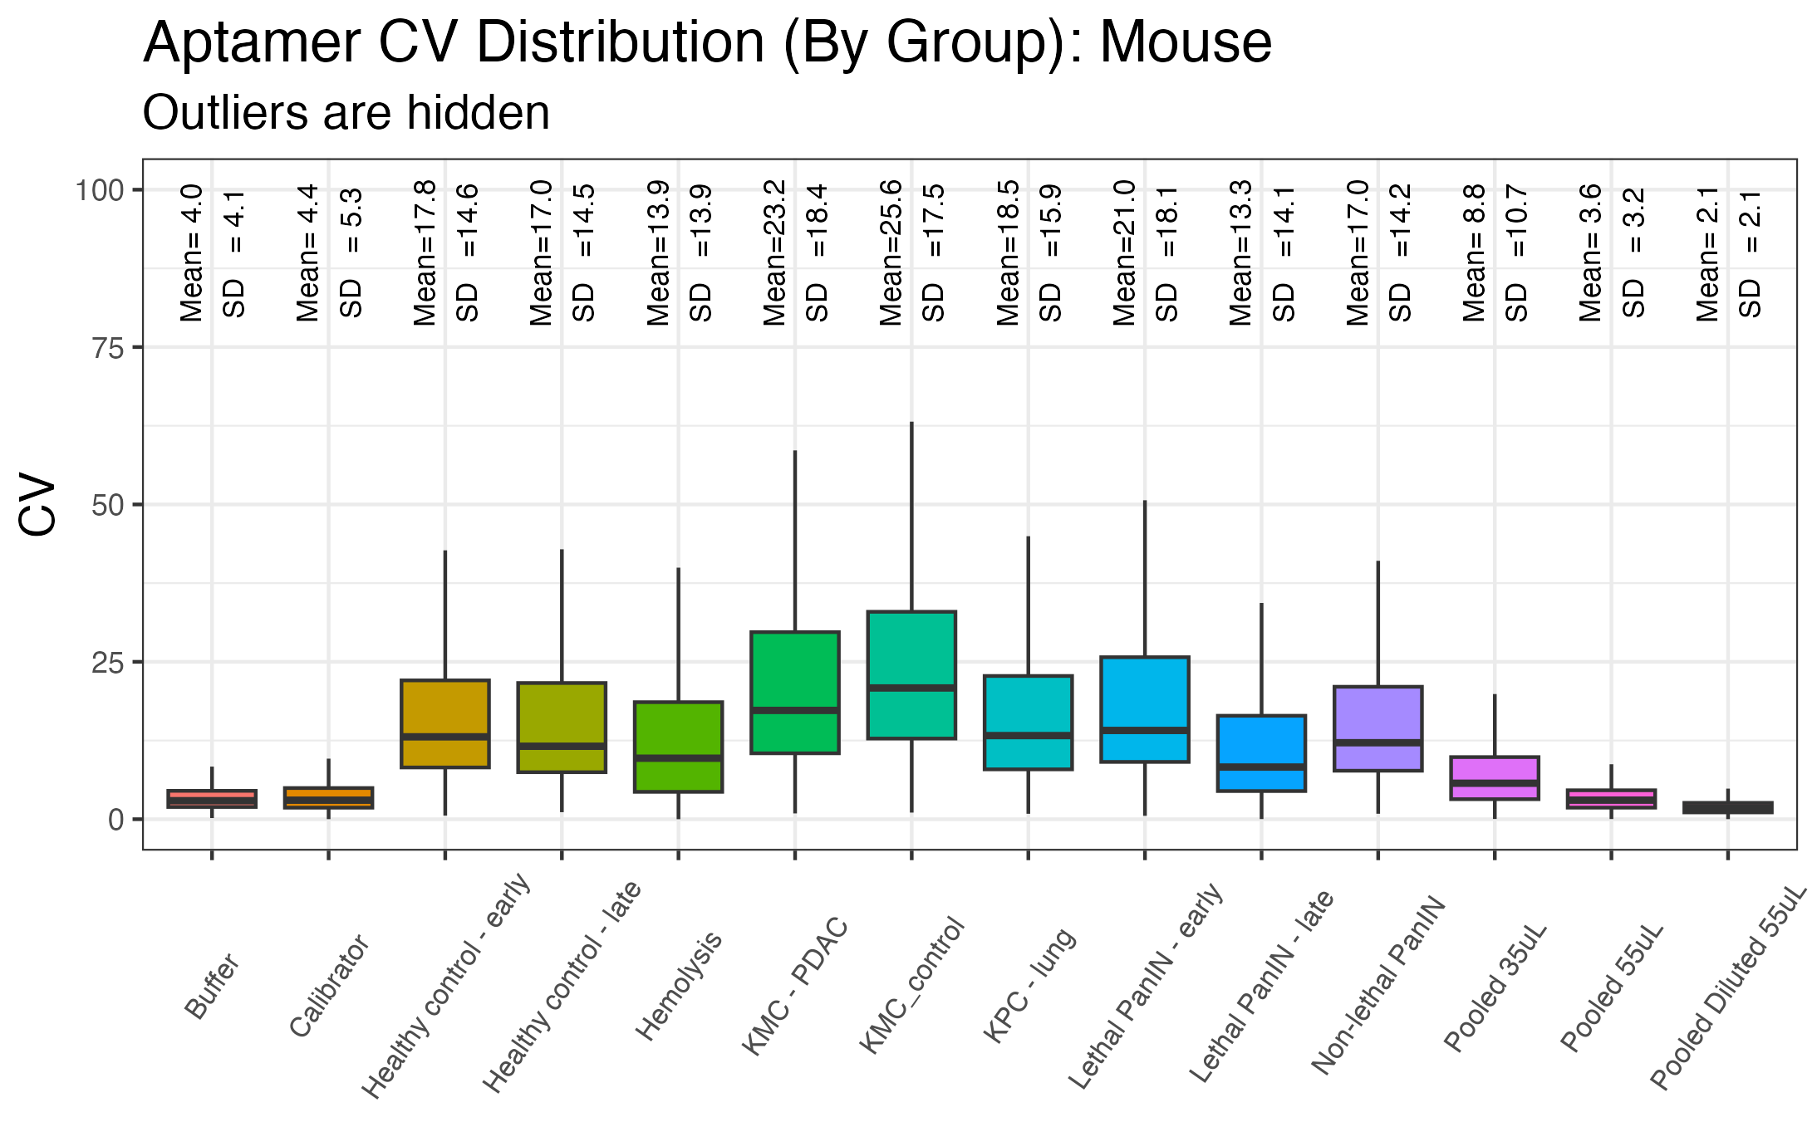
Milestone 2/6 Recap: Variance Across Mouse Samples
Very low technical assay variability, similar level of biological variability as inferred from MS
Notes:
QUESTION: The next QC analysis conducted aimed to assess the amount of variation in aptamer intensities, to get an idea of the technical variability of the assay and biological variability of our samples.
ANSWER: In this plot for the mouse data, we calculated the aptamer intensity CVs, grouped by mouse condition…
NEXT

Slide 18
Milestone 2/6 Recap: Variance Across Mouse Samples
Very low technical assay variability, similar level of biological variability as inferred from MS
Notes:
There are a couple of takeaways here:
First, the technical assay variability observed in the pooled 55uL result – marked by the red arrow – is very low. This implies promising technical reproducibility of the assay.
NEXT

Slide 19
Milestone 2/6 Recap: Variance Across Mouse Samples
Very low technical assay variability, similar level of biological variability as inferred from MS
Notes:
Second, although the aptamer counts and intensity distributions were similar between the 35uL and 55uL samples, there does appear to be more data variation in the low volume samples
Also of note is that the diluted samples have minimal variability, which will require further work to explain.
NEXT

Slide 20
Milestone 2/6 Recap: Variance Across Mouse Samples
Very low technical assay variability, similar level of biological variability as inferred from MS
Notes:
Lastly, there is a decent amount of biological variability in our main set of mouse samples – denoted in the red box
Although these samples were taken from genetically identical mice, this variability could be stemming from the murine sample collection process.
Comparatively, the amount of biological variability observed here is relatively similar to that observed in the Seer Proteograph MS analysis of these samples.
NEXT

Slide 21
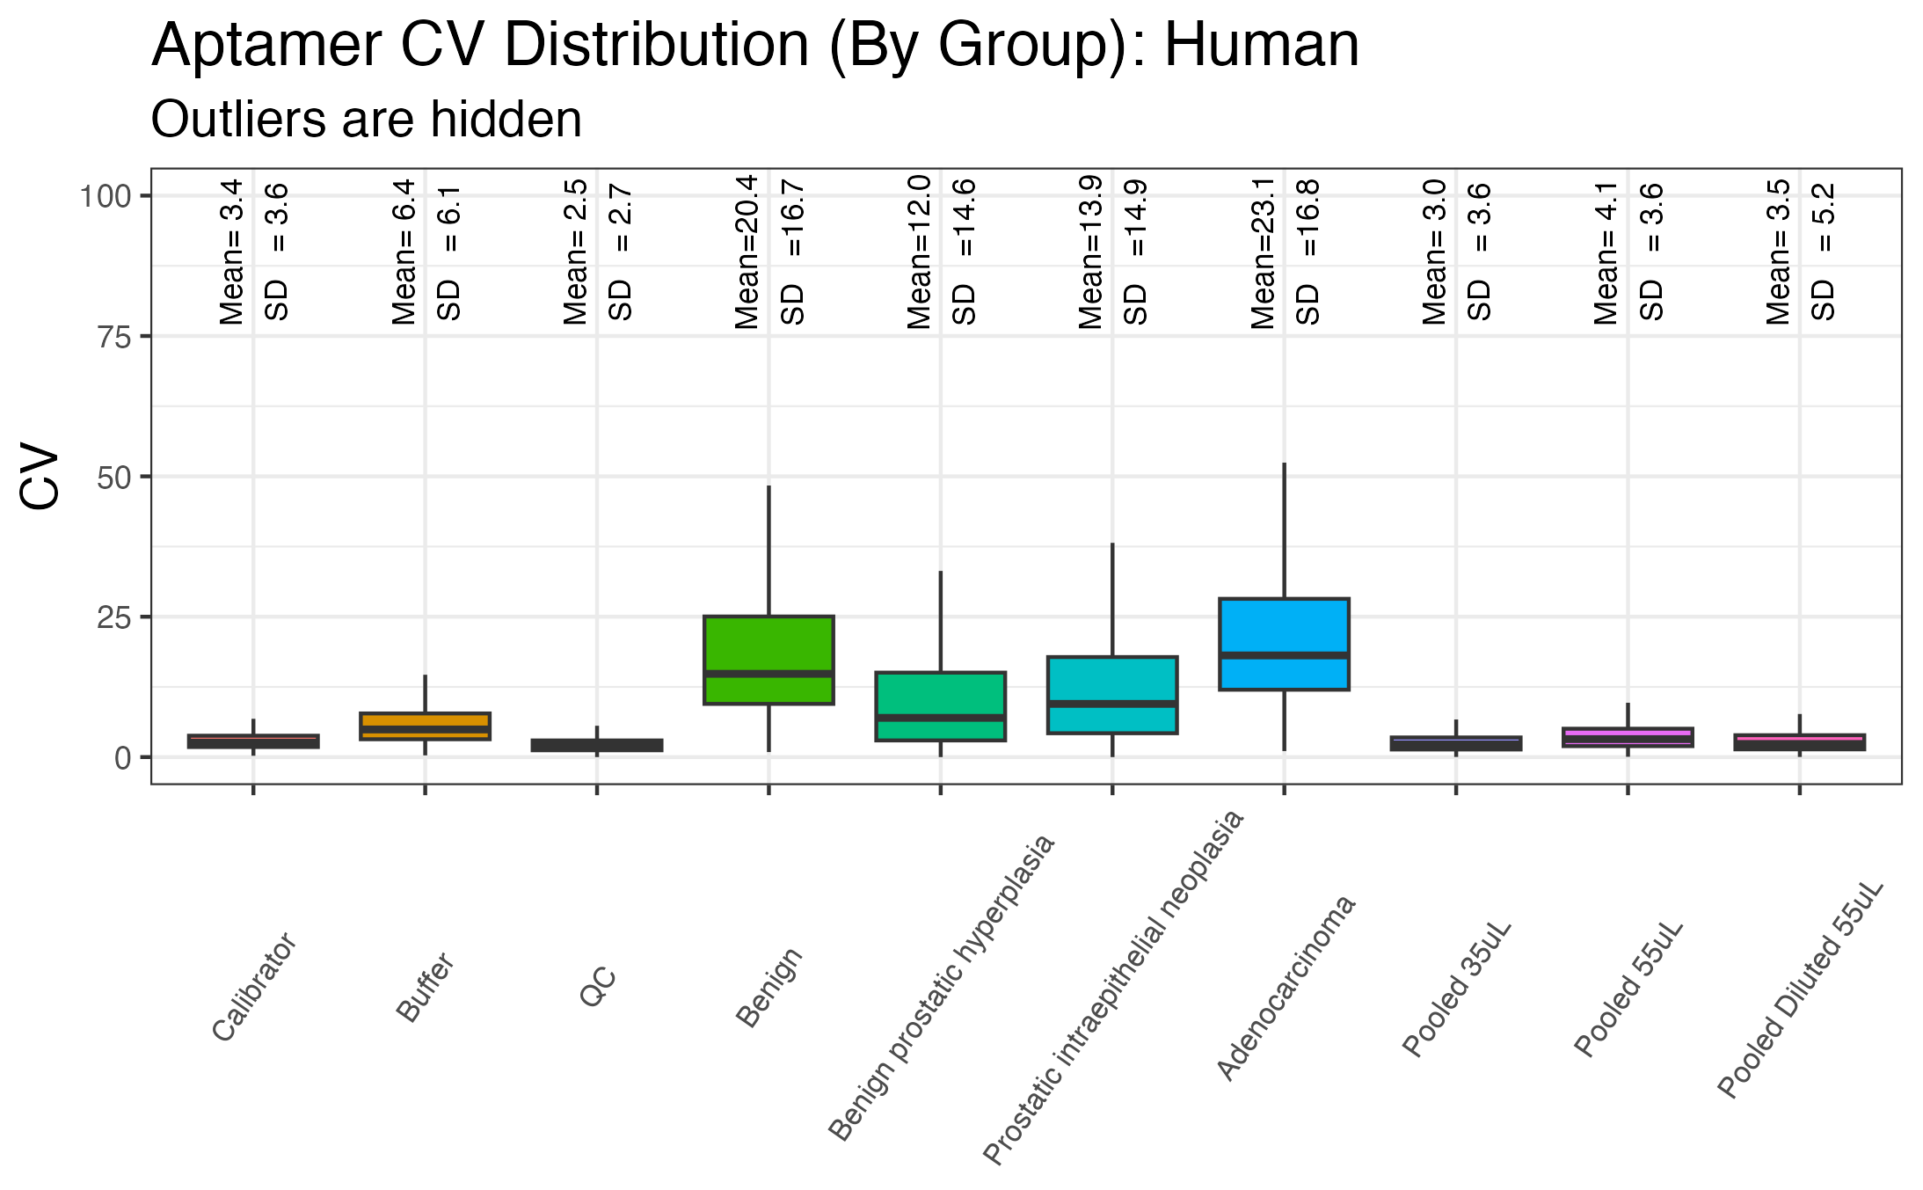
Milestone 2/6 Recap: Variance Across Human Samples
Very Low Technical Assay Variability, Similar Level of Biological Variability as Inferred from MS
Notes:
QUESTION: We created the same aptamer CV by condition plot to assess the variability of our human samples.
ANSWER: Even less aptamer variability is seen in the human sample groups – both in terms of technical and biological variability.
NEXT

Slide 22
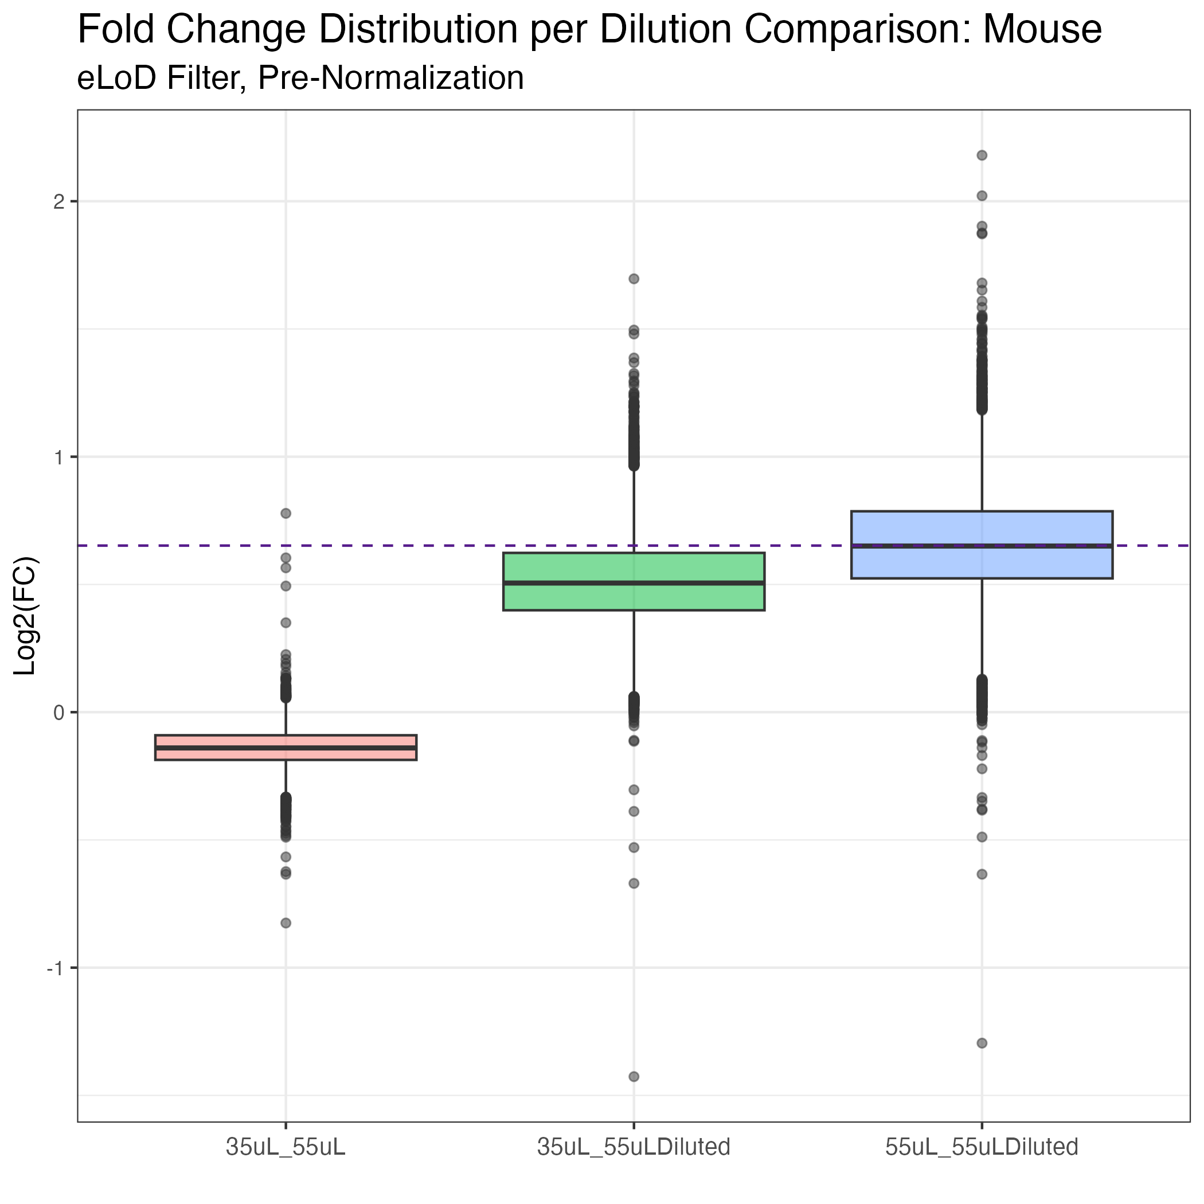
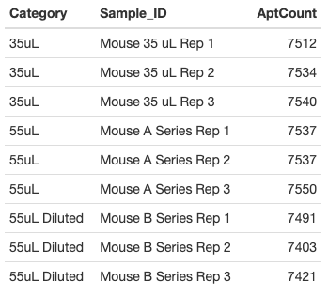
Quantitative Accuracy and Precision: Mouse Dilution Series (35uL, 55uL, 55uL Diluted)
Fewer Protein IDs in Diluted Samples, Dilutions On-Target
Notes:
The results of the murine “dilution set” analyses are shown here, demonstrating the high quantitative accuracy and precision of the SomaLogic method.
Table on the left shows the number of aptamers above noise for each sample – all counts are very high and close to the maximum 7596 aptamers, although slightly more aptamers are filtered out in the three diluted samples.
Boxplot on the right shows the distribution of FCs for aptamers across the three dilution comparisons, confirming that the median FC in each comparison was approximately on target for the expected fold change (0.6X). For comparsions involving the diluted samples, the purple dashed line shows the log2 value of the expected 0.6 target FC from 35µL to 55µL.
NEXT
[Red: Compares low volume to typical volume protein FCs. The median FC being close to 0 on the y-axis means that the expected 1:1 relationship in FC with no dilution is in fact true here.
Blue: Compares typical volume to the diluted sample protein FCs. The median FC close to the expected dilution FC marked by the purple line here indicates that the FC of most proteins do adjust as expected with the dilution from 35 to 55uL.
Green: Further reinforces the takeaways from the other two comparisons, showing that low volume to diluted sample protein FCs follow the same pattern as the typical volume to diluted sample comparison, with the median FC close to the expected dilution target.]

Slide 23
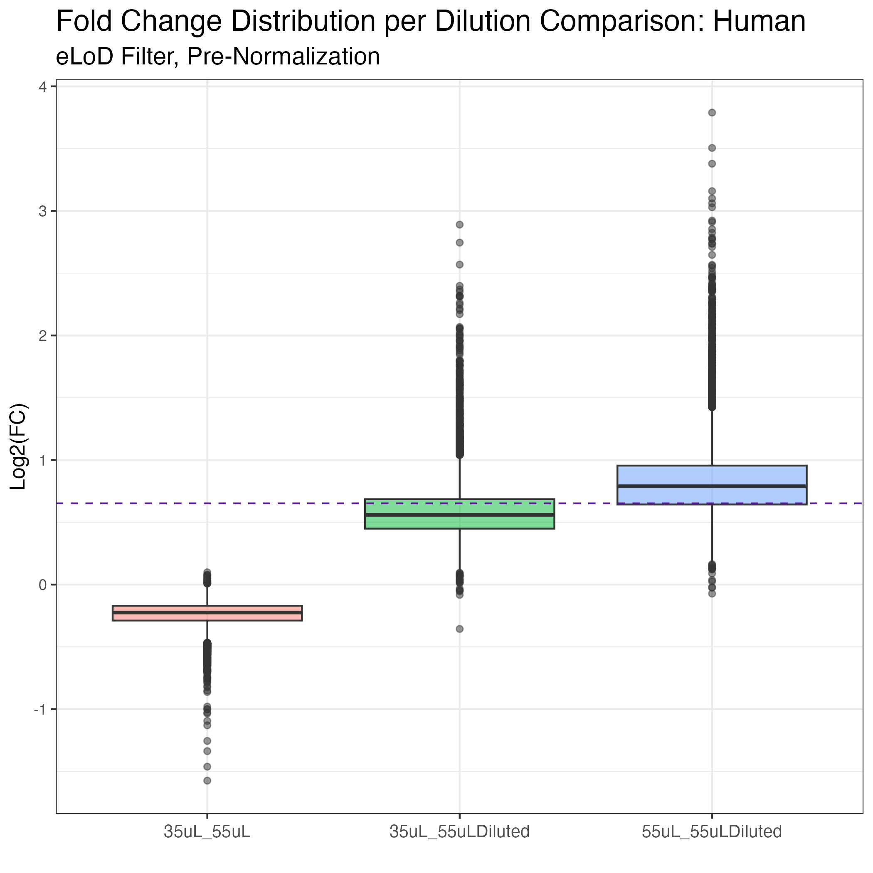
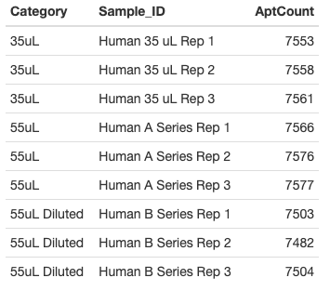
Quantitative Accuracy and Precision: Human Dilution Series (35uL, 55uL, 55uL Diluted)
Fewer Protein IDs in Diluted Sample, Dilutions On-Target
Notes:
This is the same table and FC boxplot results for the human “dilution set”
From brief observation, I would say that the human dilution appears to be even more on target for the expected FC, with slightly less variation.
NEXT

Slide 24
Summary of Initial Data Analysis on SomaLogic Outputs
Over 7000 proteins consistently measured in both human and murine plasma specimens
Samples with qualitative indications of hemolysis (pink/red color) demonstrate abnormal intensity distributions (not shown) and elevated levels of hemoglobin, but do not showed a greatly marked decrease in protein IDs compared to other samples
Low-volume samples did not demonstrate abnormal aptamer counts or intensity distributions, but may have increased variability
Intentionally diluted low-volume samples demonstrate equivalent ID target rates, but decreased pre-normalized intensities, suggesting dilution is a less viable alternative
Reassuring concordance between SomaLogic and internal data analytic pipelines
Notes:
Summary of earlier analysis presented at the previous milestone.
>7000 proteins consistently measured across samples in both the murine and human studies
Suspected hemolysis samples did results in abnormal intensity distributions and elevated hemoglobin aptamer intensities, but had similar protein ID counts to all other samples
Low volume samples had slightly increased variability, but otherwise results were not remarkably different from typical volume samples
Diluted samples, while having similar protein ID counts to other samples, demonstrated decreased pre-normalized intensities suggesting dilution less viable compared to low volume
Agreement btwn SomaLogic’s online data analysis portal DataDelve and our internal analytic pipeline.

Slide 25
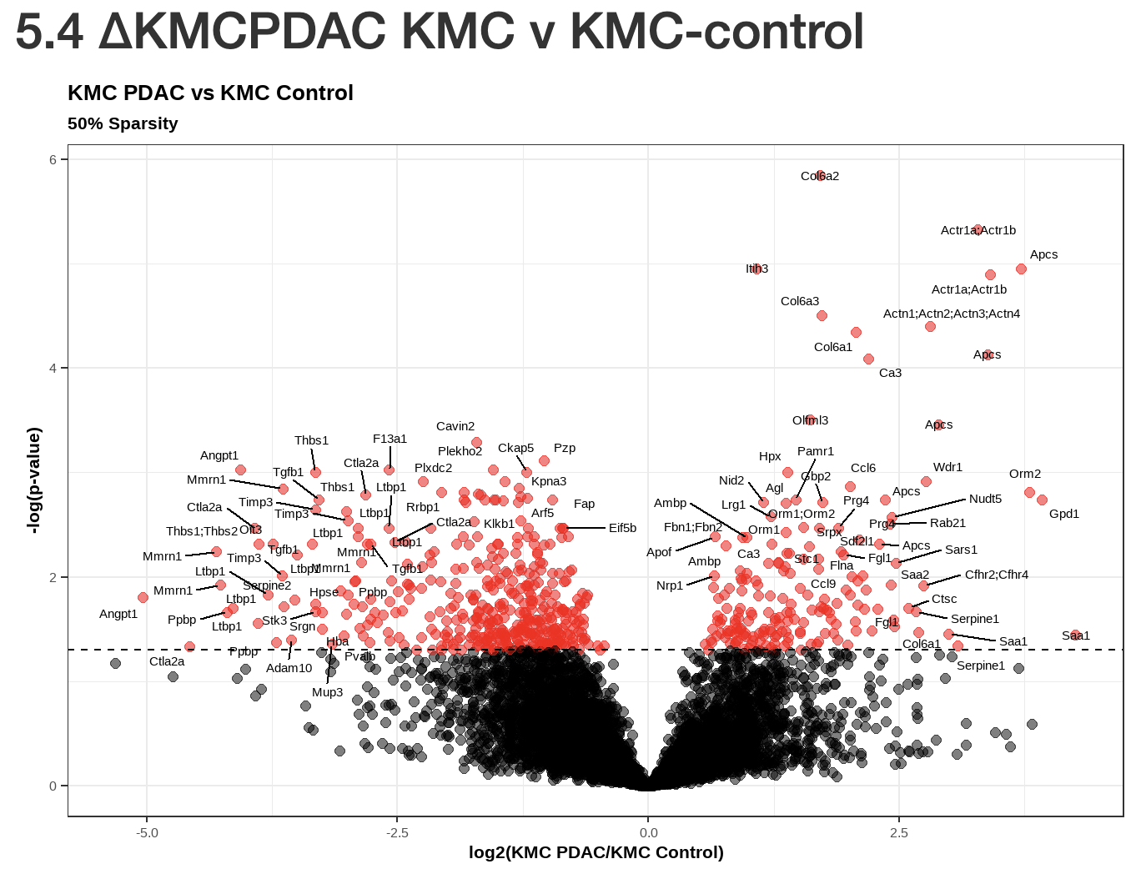
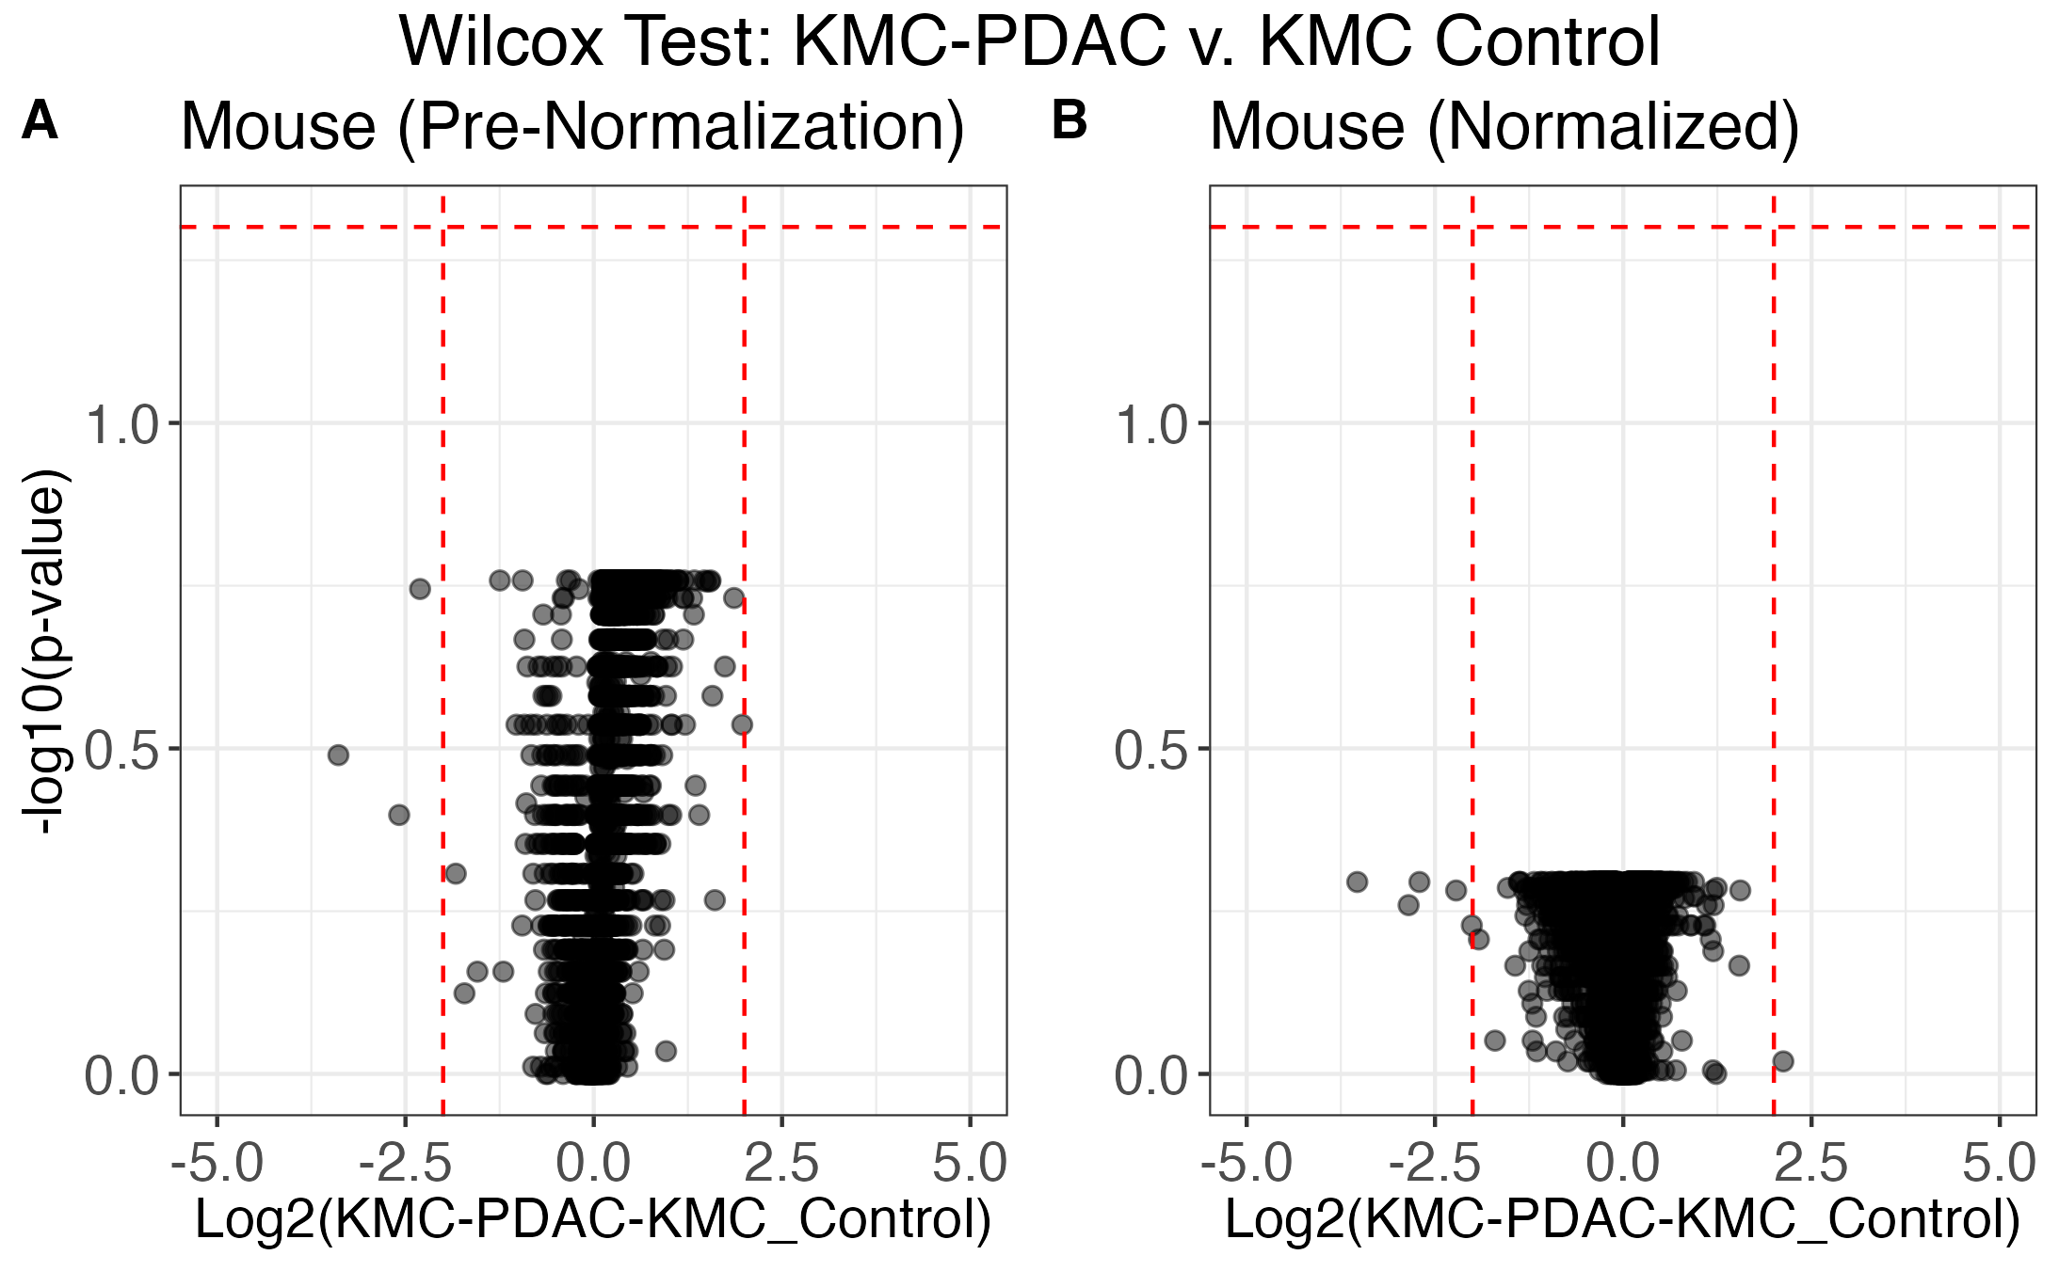
Milestone 4/7: Platform comparison of differential expression in mouse samples
Seer Proteograph MS
SomaScan
Seer MS Identifies Significant Proteins, No Significant Proteins Identified with SomaScan
Notes:
After these initial results, we then started looking at the mouse differentials first.
We knew from previous analysis of the Seer data for the murine study that at least one of the murine DE comparisons resulted in many significant protein results using the Seer Proteograph MS method.
Human differentials using initial Seer MS data did not ID any significant proteins, difficult to compare platform performance
The Seer DE results from that known condition comparison – KMC-PDAC vs. KMC control – generated from Welch’s t-tests, are shown on the left volcano plot with a 50% sparsity (sample coverage) filter applied [meaning the protein ID had to appear in at least 50% of samples for a condition to be included]. ~322 sig proteins identified, some of which Dr. Aaron Grossberg identified as potentially of clinical significance.
The right volcano plots show the pre-normalization and normalized SomaLogic results for this same comparison of KMC samples. No significant differentially expressed proteins are found with SomaScan using either Wilcox tests shown here or Welch’s tests
Given these results we wanted to directly compare FCs between platforms to see if any platform correlation can be observed.
NEXT

Slide 26
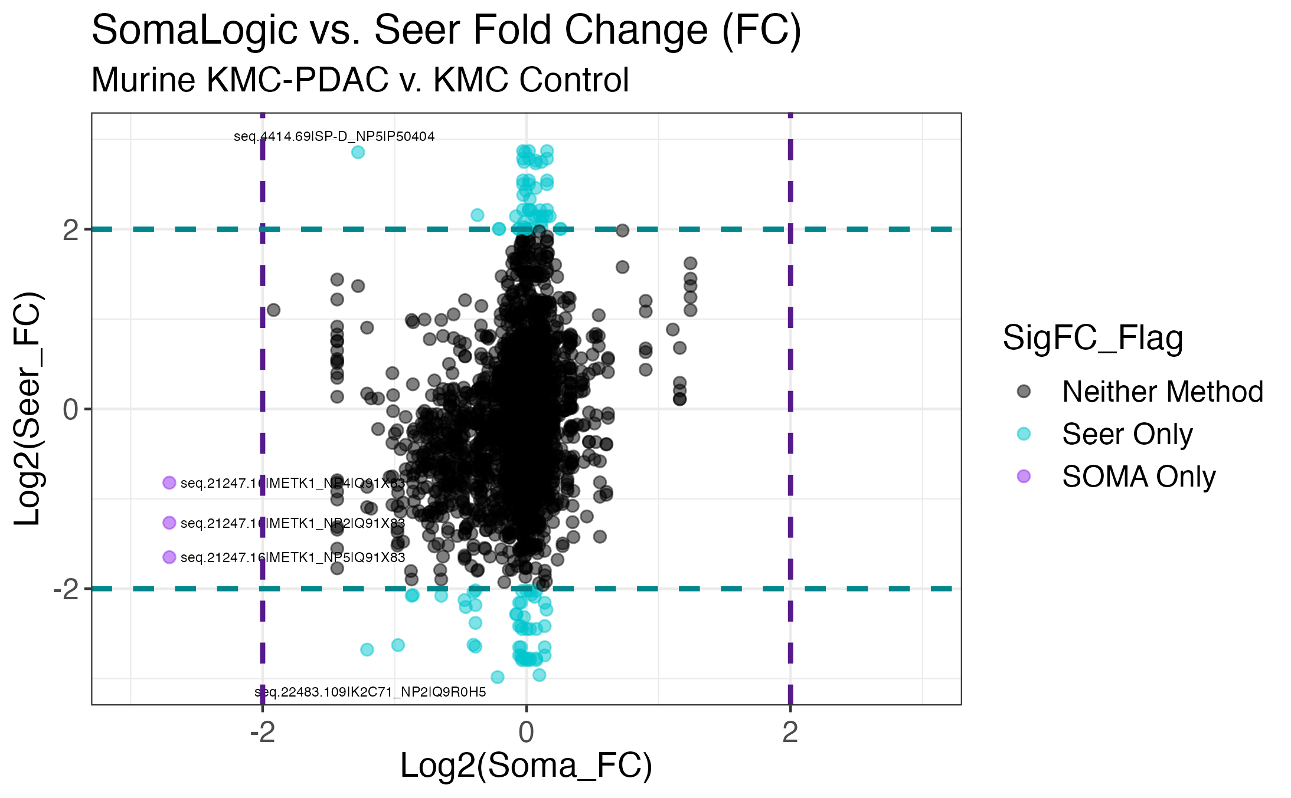
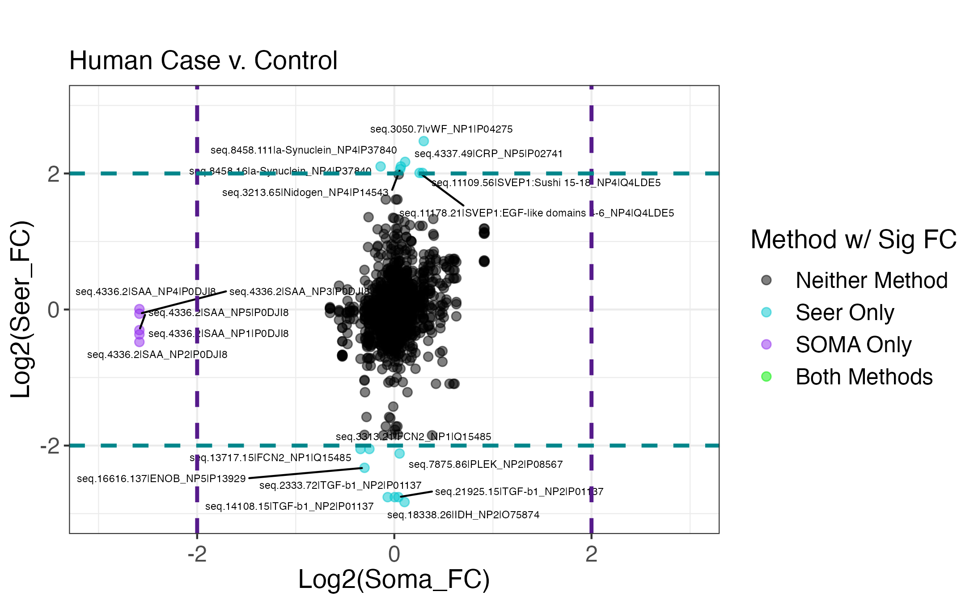
Milestone 4/7: Platform comparison of differential expression in mouse samples
Pearson’s r = 0.216
Seer MS and SomaLogic Assay Have Low Murine Fold Change Correlation
Notes:
Here, SomaLogic FC on the x-axis is plotted against Seer FC on the y-axis for each SomaLogic aptamer & Seer feature that are matched based on UniProt IDs.
This plot is for the murine KMC study.
As noted by the teal data points, several protein IDs only have a notable FC in the Seer data, with almost no FC detected in the SomaLogic data. One protein (METK1) marked by purple data points had notable FC in the SomaLogic data, while not in the Seer MS data.
Ideally, we were hoping for some manner of diagonal agreement here.
While maybe hinted at for a few IDs, cross-platform correlation is not very apparent overall with a correlation coefficient of 0.216.
NEXT

Slide 27
Milestone 4/7: Platform comparison of differential expression in human samples
Pearson’s r = 0.226
Seer MS and SomaLogic Assay Have Low Human Fold Change Correlation
Notes:
This is the same FC platform correlation plot for the human study.
There are also teal data points here, indicating several protein IDs with notable FCs only detected in the Seer data, and one protein (SAA) with notable FC only detected in the SomaLogic data.
Method agreement still very low, but slightly better than the murine with correlation coefficient at 0.226.
NEXT

Slide 28
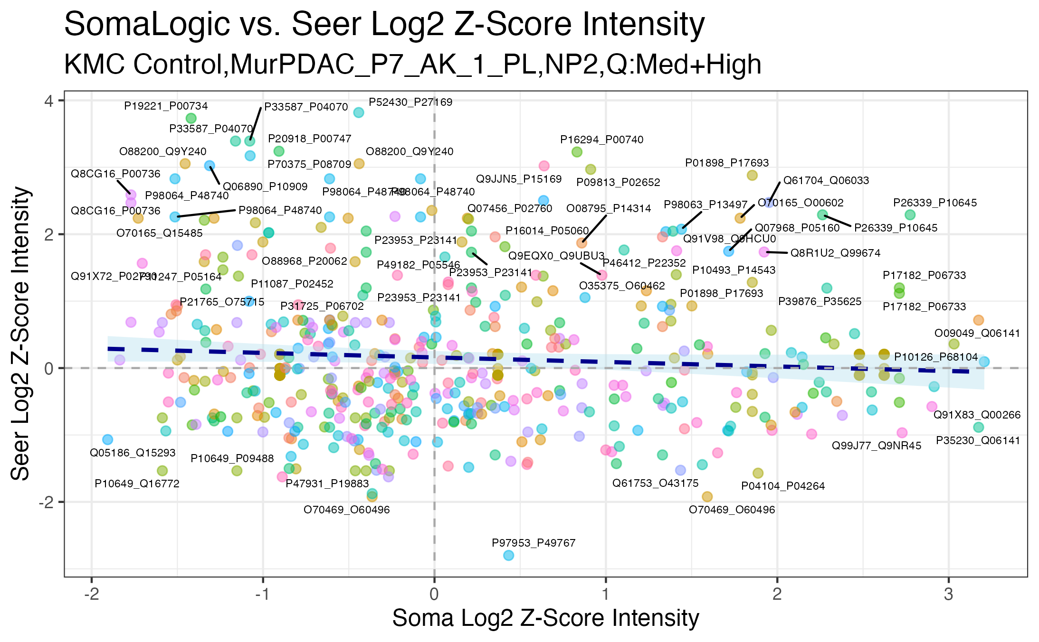
Milestone 4/7: Degree of agreement between quantitative outputs (Intensity correlation) for mouse samples
Pearson’s r = -0.074
Seer MS and SomaLogic Assay Have Low Intensity Correlation for Mouse
Notes:
On peer recommendation, we took a step back before FC calculation and statistical tests and graphically compared intensity measurements per protein ID across the two platforms, again searching for some correlation pattern.
Here, those results are shown comparing Log2 ZScore intensities between SomaLogic on the x-axis and Seer on the y-axis.
This plot shows all protein IDs in common for a single sample and single NP between both platforms, after the 50% SF for Seer and eLoD + murine aptamer quality filter for SomaLogic. The colors are irrelevant here.
Since SomaLogic only uses human UniProt IDs to label aptamer target, the “overlapping” IDs are paired, with a murine UniProt ID and corresponding human UniProt ID matched using a nomenclature pivot function. [that relies on NCBI Entrez and KEGG Orthology databases].
These results further support that SomaLogic intensity measurements do not correlate to Seer intensity measurements for most overlapping protein IDs, with a correlation coefficient of -0.074.
NEXT

Slide 29
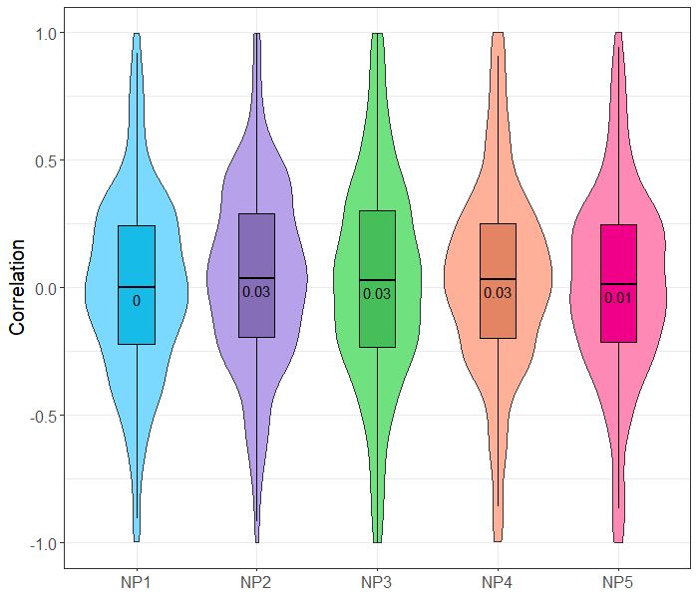
Milestone 4/7: Degree of agreement between quantitative outputs (Intensity correlation) for mouse samples
Intra-protein across samples correlation
Seer MS and SomaLogic Assay Have Low Intensity Correlation for Mouse
Notes:
These violin boxplots show the same results from the last side, but across the entire murine KMC study arm.
These distributions reflect the correlation coefficients from multiple proteins across all samples.
Overall, we observe low correlation between the SomaLogic and Seer platforms, with most median correlation coefficients close to 0, although there is a relatively large spread.
NEXT

Slide 30
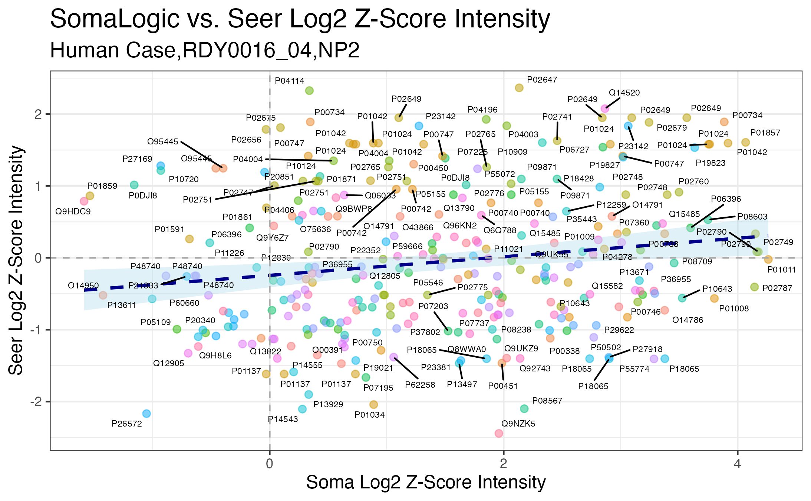
Milestone 4/7: Degree of agreement between quantitative outputs (Intensity correlation) for human samples
Pearson’s r = 0.166
Seer MS and SomaLogic Assay Have Low Intensity Correlation for Human
Notes:
This is the same type of platform-comparison Log2 ZScore intensity correlation plot for an example human sample and a single NP.
Because both SomaLogic and Seer data is labeled with human UniProt IDs, a nomenclature pivot was not necessary to determine overlapping IDs.
While there is slightly more correlation between platforms for this human data, the correlation coefficient is still very low at 0.166.
NEXT

Slide 31
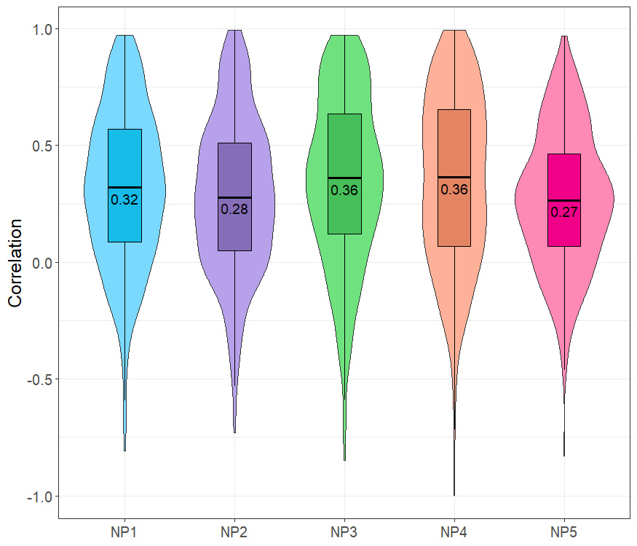
Milestone 4/7: Degree of agreement between quantitative outputs (Intensity correlation) for human samples
Intra-protein across samples correlation
Seer MS and SomaLogic Assay Have Low Intensity Correlation for Human
Notes:
Again, these violin boxplots show the same results from the last side, but across the entire study of human samples.
These distributions reflect the correlation coefficients from multiple proteins across all samples.
Overall, we observe low, but slightly better correlation between the SomaLogic and Seer platforms with this human dataset, with most median correlation coefficients btwn 0.2-0.3.
NEXT

Slide 32
Summary of Platform Comparison and Benchmark
SomaScan showed desirable technical assay strengths in proteomic coverage, assay variability, and quantitation.
Platform comparison yielded low overlap in identifications and poor correlation in fold-changes and z-scored intensities.
Absence of any statistically significant differential protein expression is concerning and call into question the usage of this platform in non-human indications.
Other emerging work presented at conferences and a few recent publications recapitulate the results shown here for human samples.
We do not feel the platform is an acceptable alternative as a validation approach for discovery-based MS findings or as a discovery tool for non-human samples types. The platform could be useful in very limited, specific use cases with human samples where MS approaches would be unsuitable.
Notes:
In conclusion:
Irrespective of reagent specificity which remains questionable, SomaScan has demonstrated desirable technical assay performance in terms of proteomic coverage, assay variability, and quantitation.
However, protein ID overlap btwn the SomaLogic and Seer platforms is very low for these two studies, and poor correlation is observed in FC and Z-Scored intensities
Furthermore, the absence of statistically significant differential protein expression in the case of the murine KMC study arm is alarming due to the biological study design of this comparison, and calls into question the feasibility of the SomaScan platform for non-human applications.
Other recent work in this area of proteomic method comparison further reinforce our results presented here for human samples.
At this time, we do not feel the platform is an acceptable alternative as a validation approach for discovery-based MS findings, or as a discovery tool for non-human sample types.
SomaLogic may be considered again for limited use in specific cases where MS methods are unsuitable.
NEXT

Slide 33
Budget
​ | Interval 1​ |  | Interval 2​ |  | Interval 3
Category​ | 6 months​ |  | 12 months​ |  | 18 months
​ | Budget​ | Actuals​ | Budget​ | Forecast​ | Budget | Forecast
Supplies​ (e.g. reagents)​ | 0​ | 0​ | 10,500​ | 0​ | 0 | 0
OHSU Core Services Fees​ (e.g. sequencing, biostats)​ | 0​ | 0​ | 0​ | 0​ | 0 | 0
Human Samples​ | 0​ | 0​ | 0​ | 0​ | 0 | 0
Animals​ | 0​ | 0​ | 0​ | 0​ | 0 | 0
Core Equipment​ | 0​ | 0​ | 0​ | 0​ | 0 | 0
Other​ (e.g. specialized software, outside services)​ | 93,400​ | 78,000​ | 0​ | 0​ | 4,000 | 0
Non-CEDAR Personnel​ | ​ | ​ | ​ | ​ | 0 | 0
CEDAR Personnel​ | 9,828​ | 9,828​ | 13,451​ | 13,451​ | 21,376 | 21,376
TOTALS​ | 103,228​ | 87,828​ | 23,951​ | 13,451​ | 25,376 | 21,376

Slide 34
Project Output Summary
Assessment of proteomic profiling capability infrastructure complimentary to our existing platforms (Seer Proteograph, timsTOF mass spectrometry) revealed low platform agreement and concerning results that would preclude its use in most proteomic applications
Low overlap of proteins in Proteograph MS coupled with poor quantitative correlation makes SomaScan a poor platform for validation of targets discovered in our scaled prostate cancer diagnostic biomarker discovery study.
New Proteograph format amenable to low inputs render a prior advantage for SomaScan obsolete.
Follow-on CEDAR project
Grant proposal
Manuscript
CEDAR Infrastructure
Patent
Other

Slide 35
Supporting material

Slide 36
SomaScan Built-In Quality Control Measures
96- well plate > 11 wells used for replicated controls
Calibrator Controls – real biological samples checking plate-to-plate variation
QC Controls – pool of many individual samples – compare to historical reference (human samples only)
Buffer Controls – No protein control – monitors background level of assay
Specimen dilution series to account for large dynamic range of proteome
Serial dilutions of plasma to 20%, 0.5% and .005% of original volume
Normalization routines
Median normalization on Calibrator Controls, and then on Buffer Controls
Plate Scaling – compares Calibrators against reference, tunes plates and possible future plates to same point
Calibration – done across proteins on the plate (not for murine samples, no Calibrant to compare against)
Adaptive Normalization by Maximum Likelihood (ANML) – normalizes against a healthy reference population
Asks what is “normal” level of each proteins, and how does your sample compare?
Ignores levels with greatest differences to avoid data skewing
Murine “Intra-Study Median Normalization” – looks at median across all samples and then adjusts accordingly
Sample flagging based on routines above

Slide 37
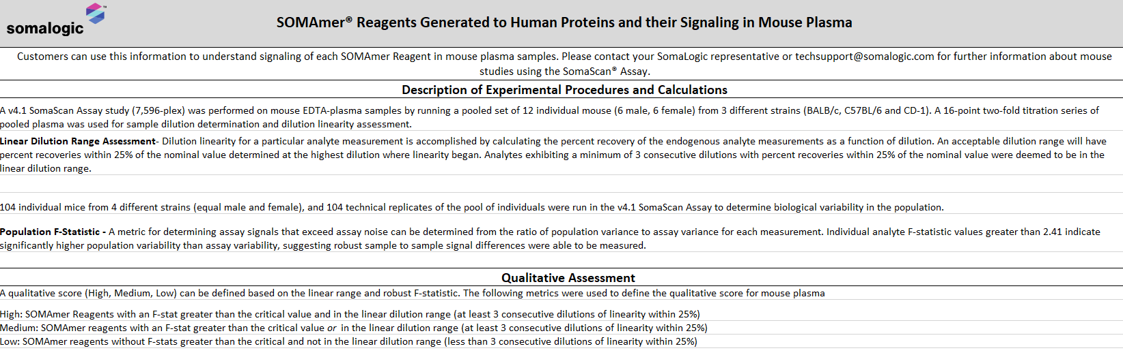
SomaLogic Assays for Murine Target Specificity
Linear Dilution Range Assessment:
determines where linear range lies by analyzing dilution of pooled murine input plasma
Population F-Statistic:
compares population variance to assay variance for each aptamer when input is murine plasma from 104 individual mice

Slide 38
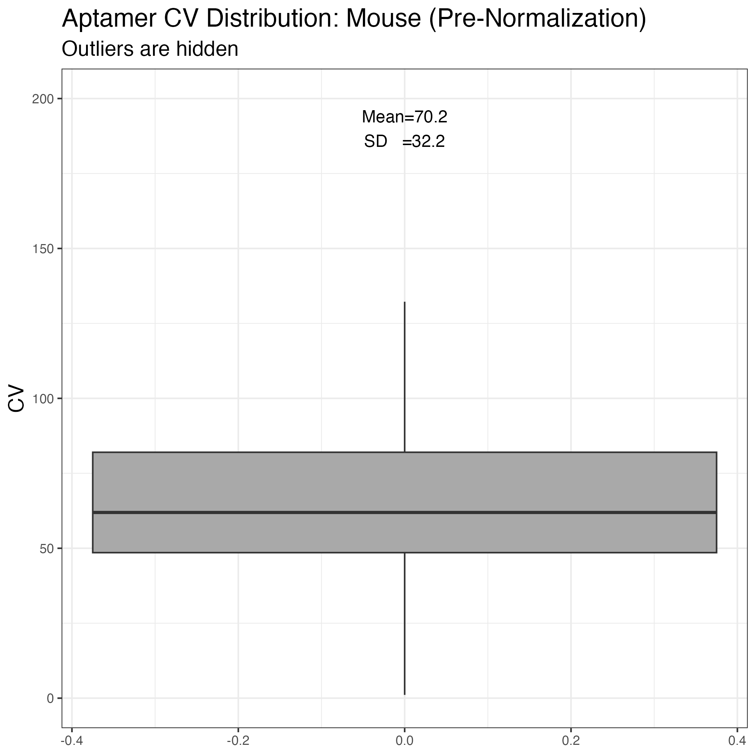
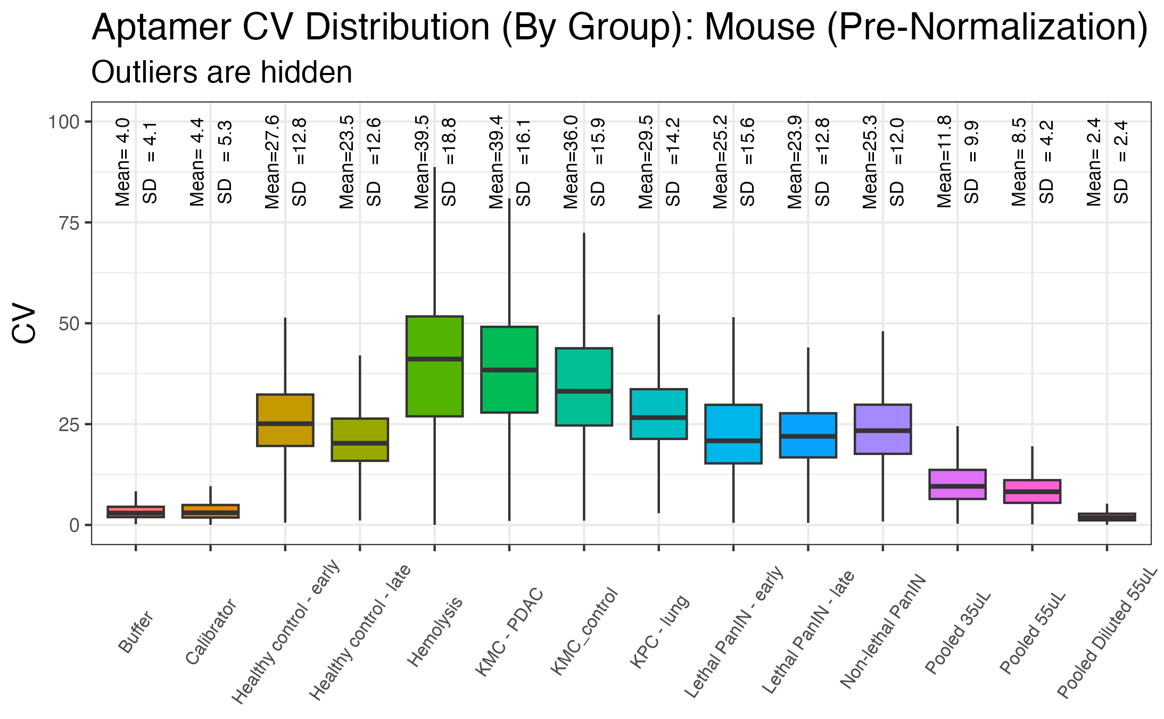
Milestone 2: Initial data analysis on SomaLogic outputs
Aptamer CV Across Mouse Samples
Very low technical assay variability, similar level of biological variability as inferred from MS
Notes:
There are a couple of takeaways from this data:
1. The assay variability as seen from the CV distribution for the pooled 55 uL sample is quite low (~3.6% mean). Very similar to what is observed in the buffer and calibrator.
2. Interestingly, the lower sample input, 35 uL, results in elevated CVs, which implies that while you retain similar levels of sampling depth and intensities, you do seem to incur a hit in measurement variability.
Conversely, the diluted sample actually shows an even lower and tighter measurement variability. Not what I would have expected.
Even within mouse groups, we observe a reasonable (and perhaps unsurprising) amount of variability between what are genetically identical mice.
Our levels of biological and mouse-preparative variability seem to be more or less in line with what we observe from Proteograph MS.

Slide 39
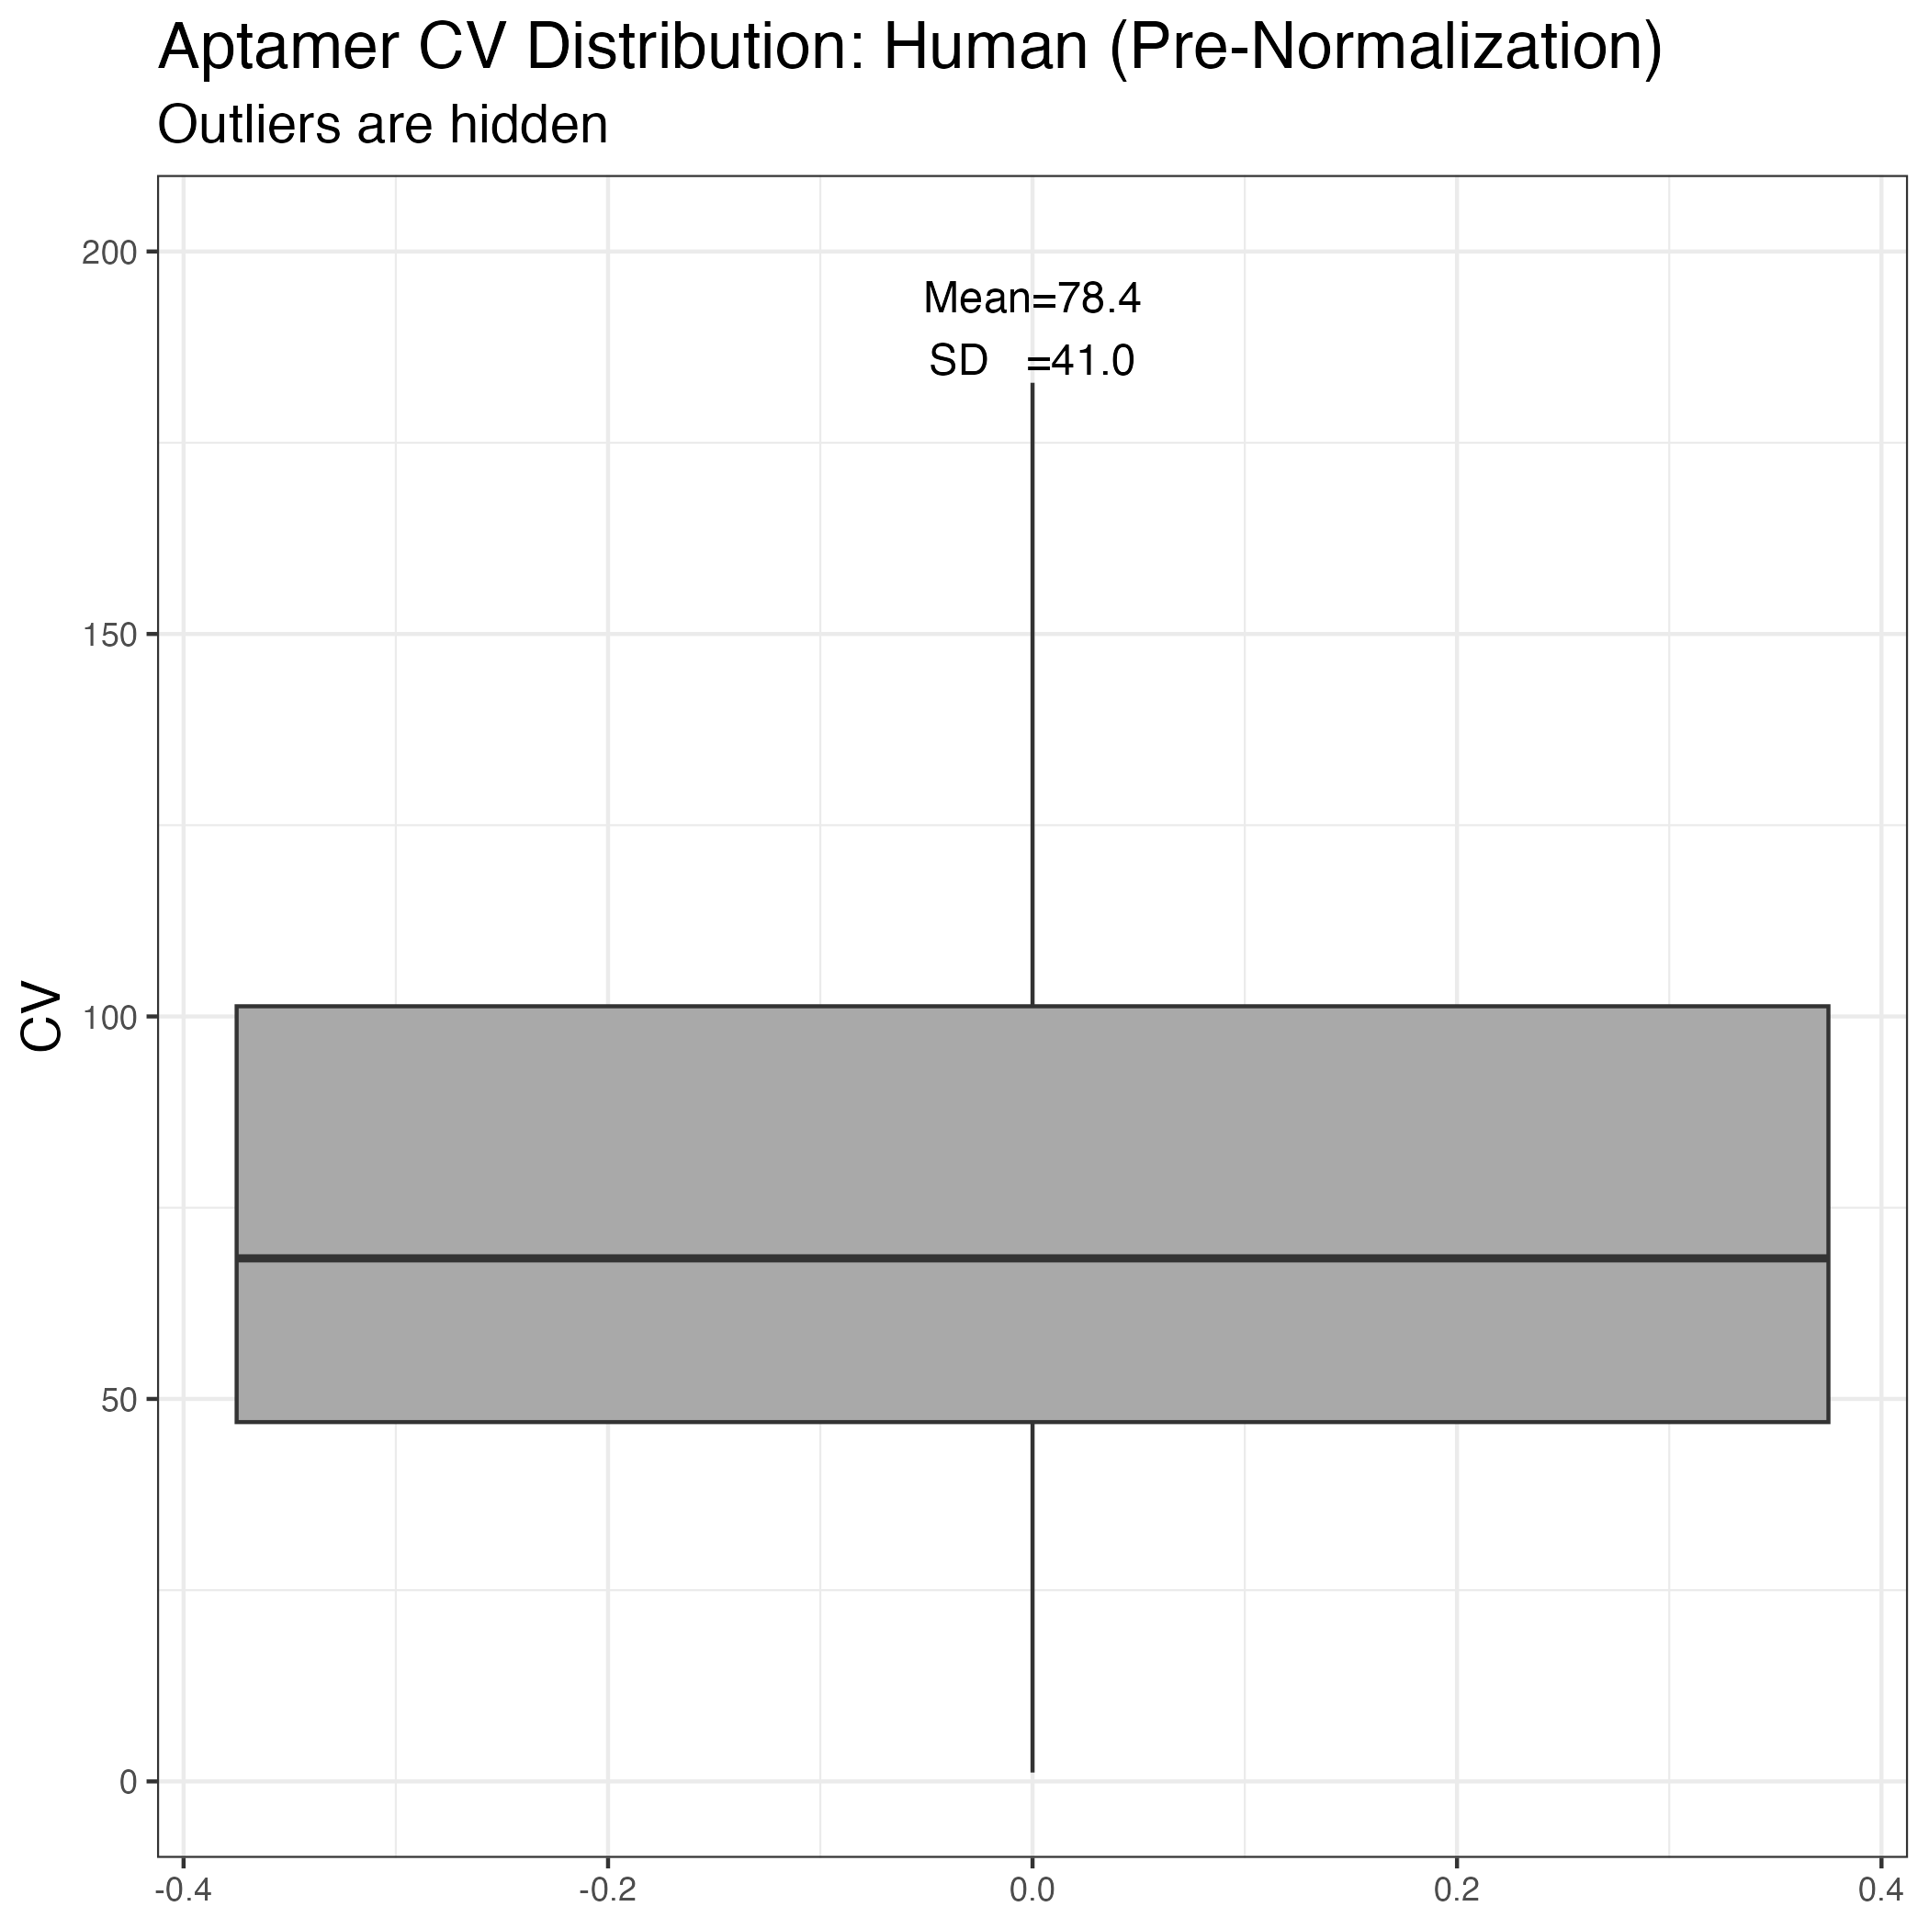
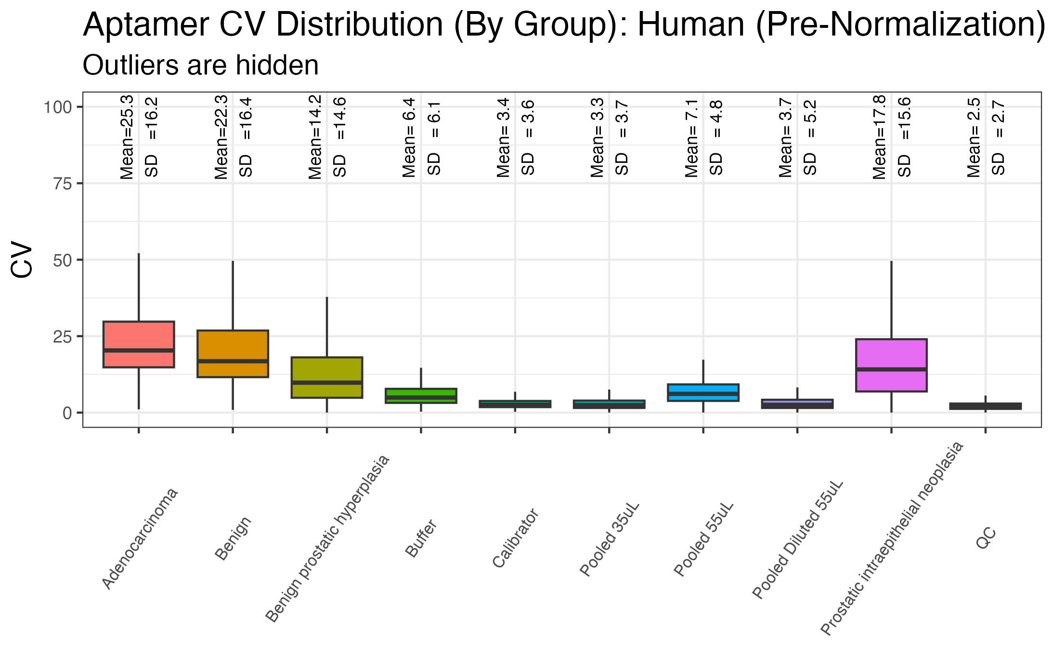
Milestone 2: Initial data analysis on SomaLogic outputs
Aptamer CV Across Human Samples
Very low technical assay variability, similar level of biological variability as inferred from MS
Notes:
There are a couple of takeaways from this data:
1. The assay variability as seen from the CV distribution for the pooled 55 uL sample is quite low (~3.6% mean). Very similar to what is observed in the buffer and calibrator.
2. Interestingly, the lower sample input, 35 uL, results in elevated CVs, which implies that while you retain similar levels of sampling depth and intensities, you do seem to incur a hit in measurement variability.
Conversely, the diluted sample actually shows an even lower and tighter measurement variability. Not what I would have expected.
Even within mouse groups, we observe a reasonable (and perhaps unsurprising) amount of variability between what are genetically identical mice.
Our levels of biological and mouse-preparative variability seem to be more or less in line with what we observe from Proteograph MS.

Slide 40
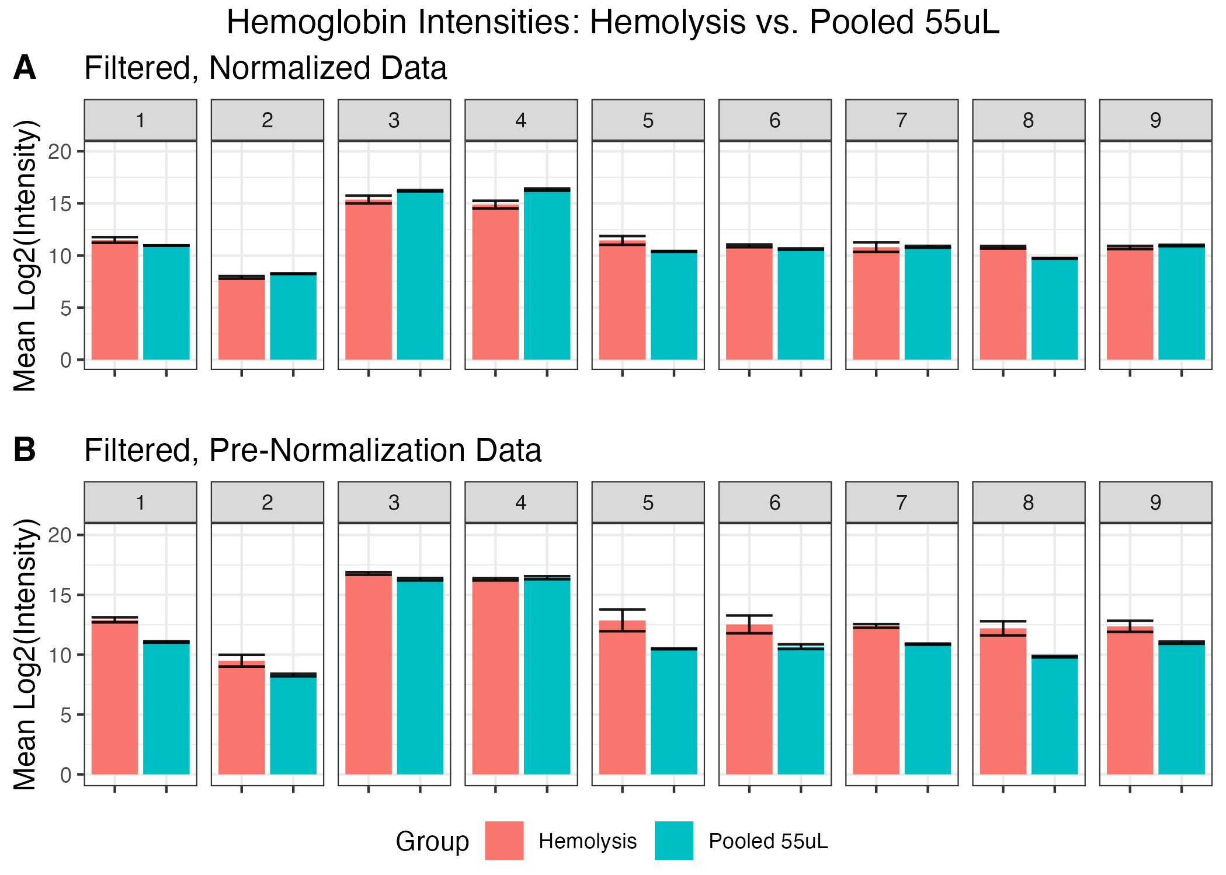
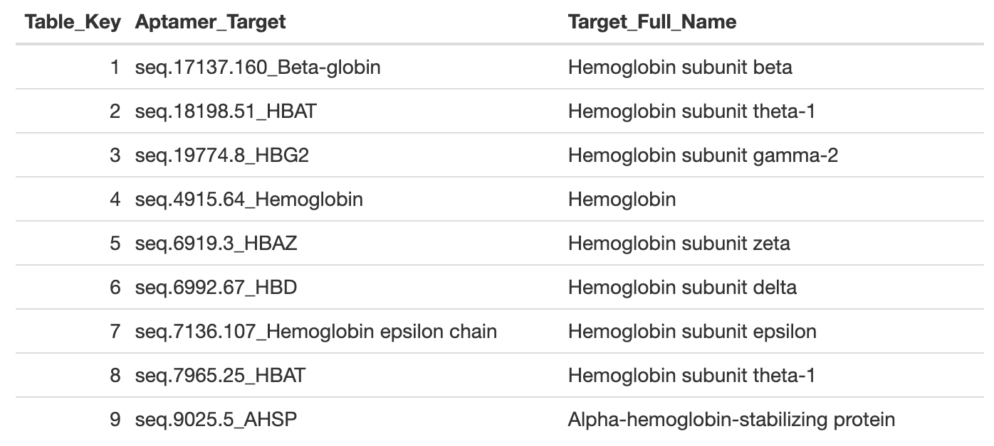
Milestone 2: Initial data analysis on SomaLogic outputs
Mouse Hemolysis Analysis - Hemoglobin
Elevated Hemoglobin in Pre-Normalized Hemolysis Samples
Notes:
Take out normalized data reference - just include pre-norm ver
SomaLogic Hemolysis Marker Proteins Label instead of table
Pink/red instead of hemolysis
Add to supplemental
Haptoglobin - no diff

Slide 41
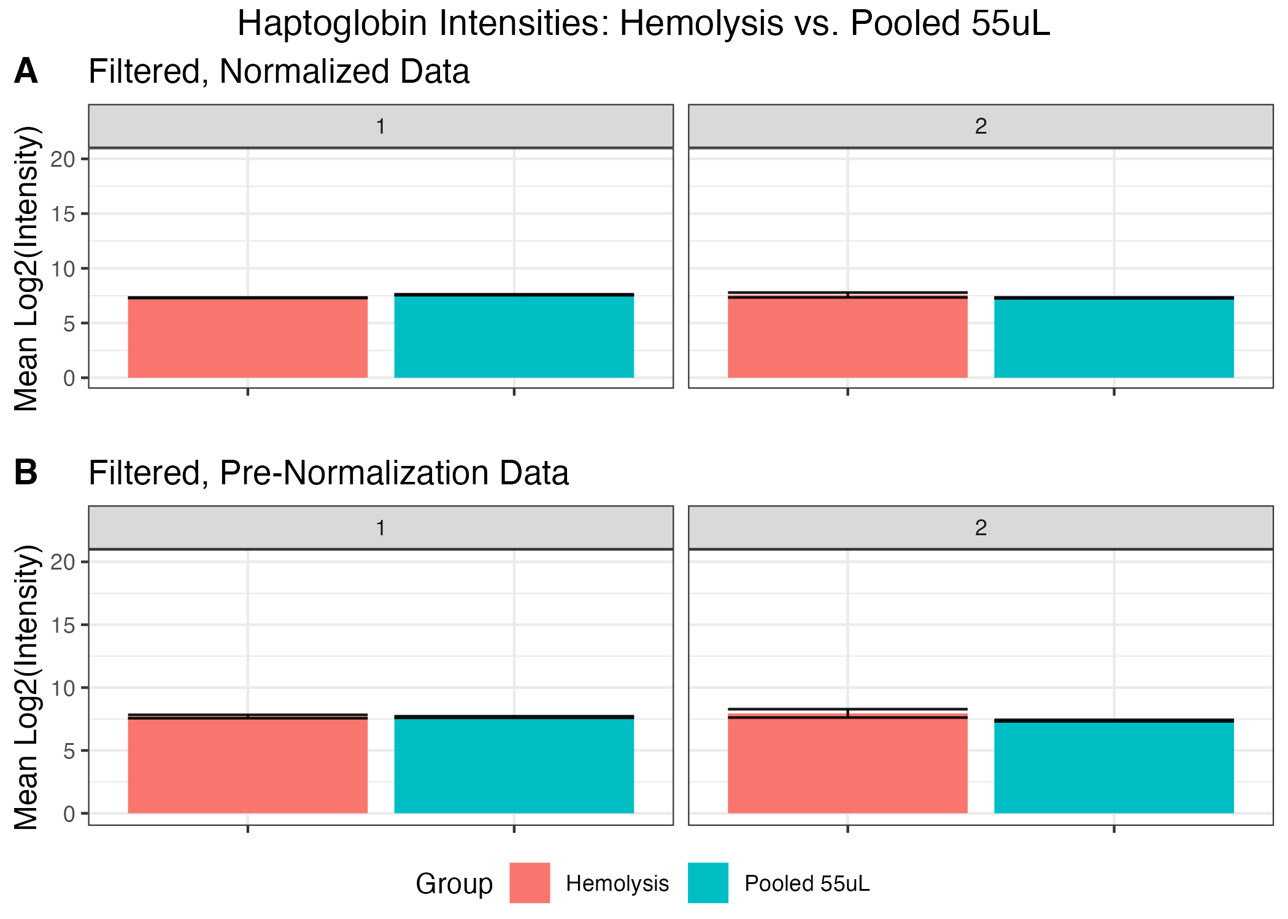
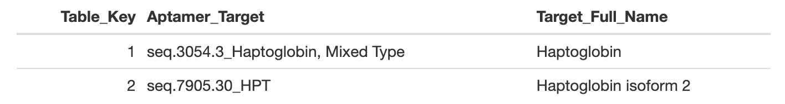
Milestone 2: Initial data analysis on SomaLogic outputs
Mouse Hemolysis Analysis - Haptoglobin
Little to No Difference in Haptoglobin Intensities in Hemolyzed Samples
Notes:
cut

Slide 42
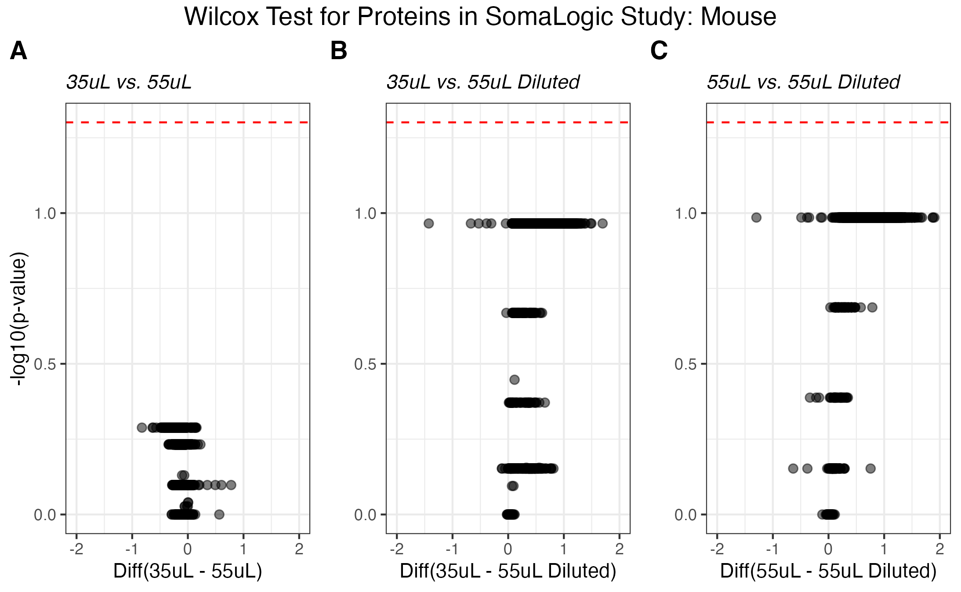
Milestone 2: Initial data analysis on SomaLogic outputs
DE: Mouse Dilution Series (35uL, 55uL, 55uL Diluted)
Fewer Protein IDs in Diluted Samples but No Significant, Differential Abundance
Notes:
7422 tests performed in each plot (7422 aptamers with sufficient coverage, >1 rep)
Lower volumes - quantitative differences
Start with table on left with counts
Don't mention FC expected v. actual
Remove slide

Slide 43
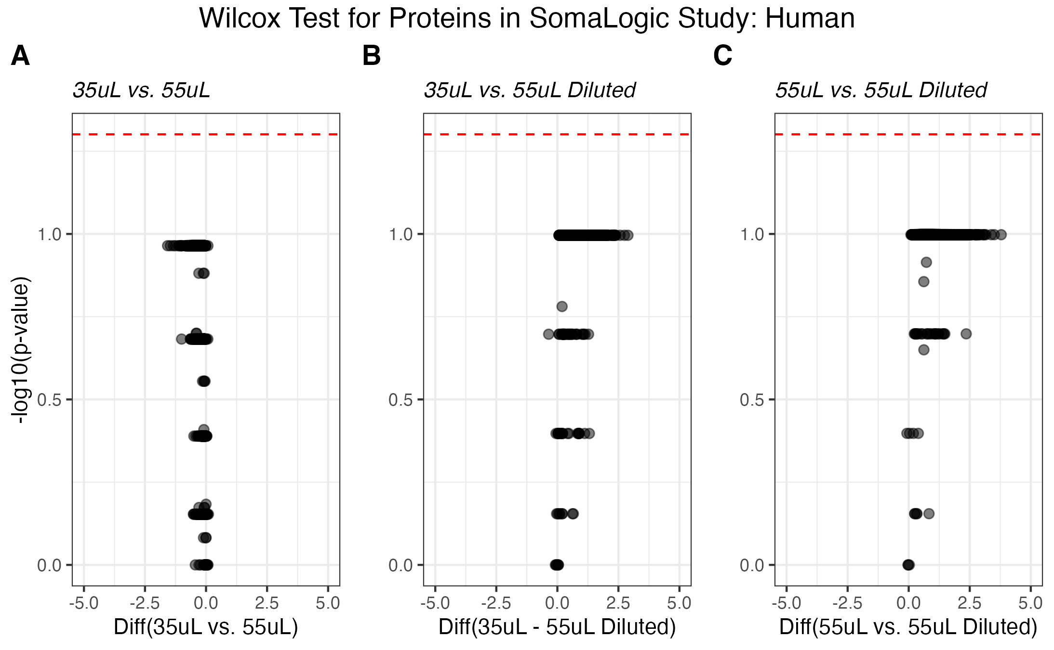
Milestone 2: Initial data analysis on SomaLogic outputs
DE: Human Dilution Series (35uL, 55uL, 55uL Diluted)
Fewer Protein IDs in Diluted Samples but No Significant, Differential Abundance
Notes:
7491 tests performed in each plot (7491 aptamers with sufficient coverage, >1 rep)
Remove slide

Slide 44
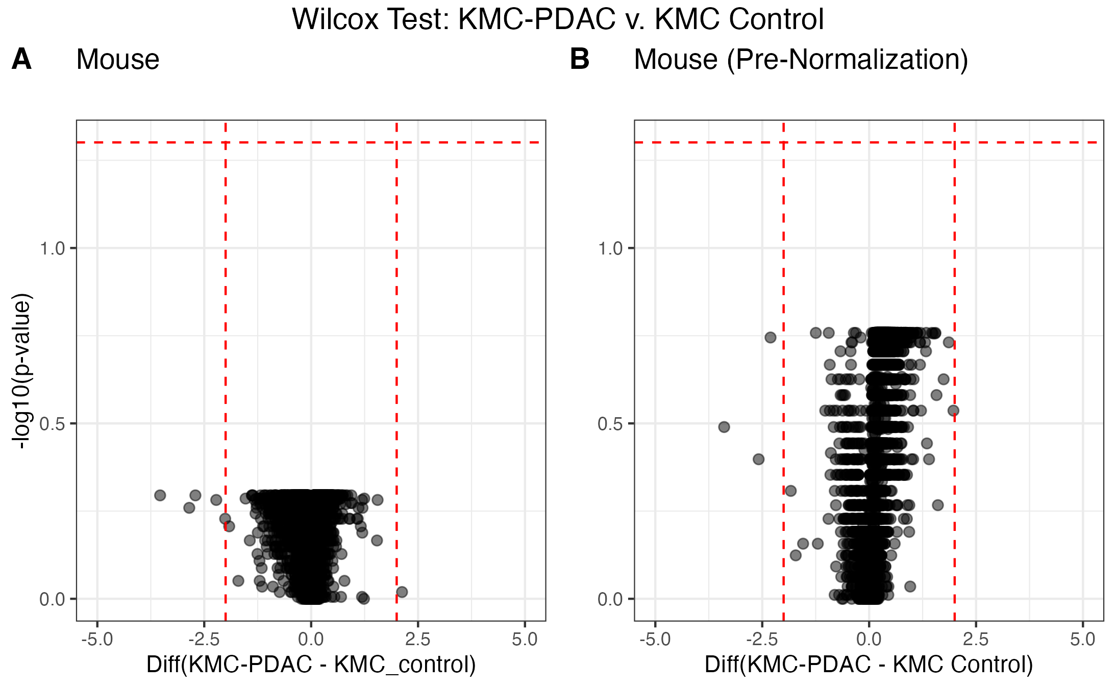
Milestone 2: Initial data analysis on SomaLogic outputs
DE: KMC-PDAC v. KMC Control
No Significant Proteins Identified Between Mouse Arms of the Study
Notes:
476 overlapping protein IDs btwn Soma and Seer methods for KMC-PDAC v. KMC control
From 7545 total Soma aptamers and 2571 total Seer proteins in each DE analysis
57 of these overlap proteins have at least one significant Seer result (some multiple due to NPs)
57 out of 322 significant proteins found in the Seer KMC-PDAC v. KMC control DE analysis overlap with the SOMA assay (but are not significant in that dataset)

Slide 45
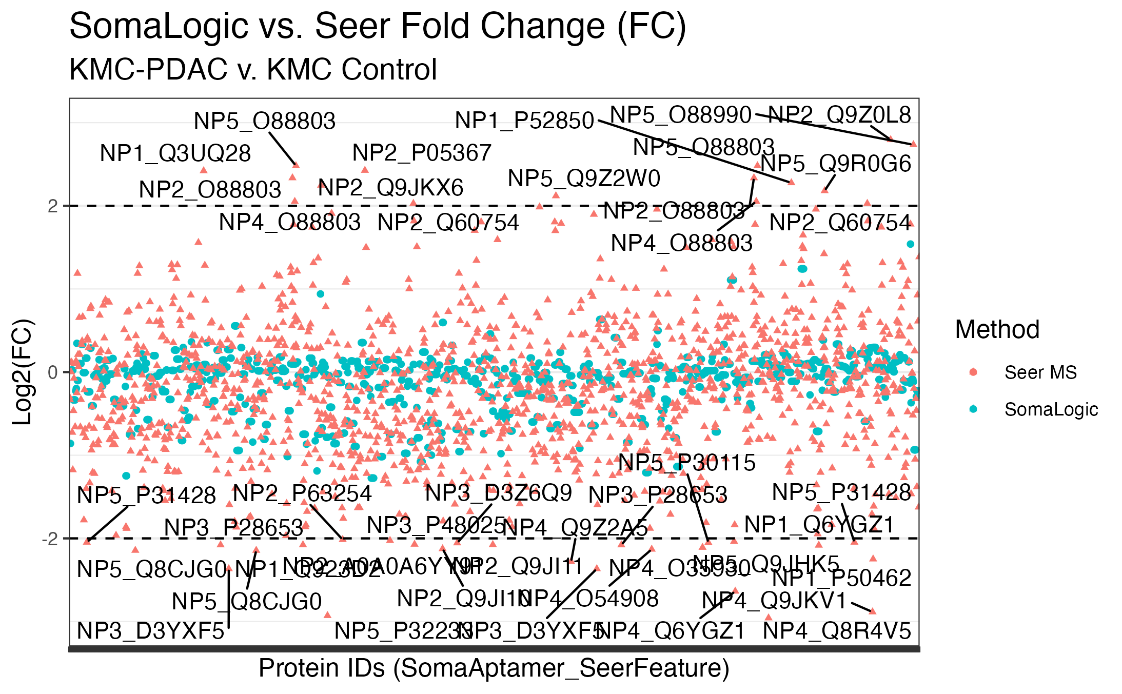
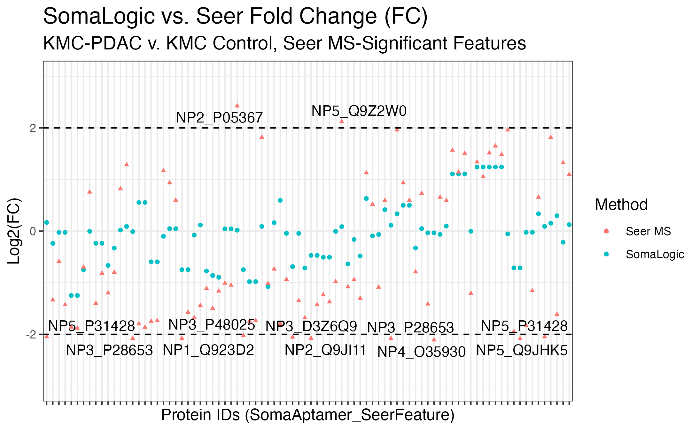
Milestone 2: Initial data analysis on SomaLogic outputs
DE: KMC-PDAC v. KMC Control – SomaLogic v. Seer FC Comparison
Seer MS Detects Larger Magnitude Fold Changes than SomaLogic Assay
Notes:
476 overlapping protein IDs btwn Soma and Seer methods for KMC-PDAC v. KMC control
From 7545 total Soma aptamers and 2571 total Seer proteins in each DE analysis
57 of these overlap proteins have at least one significant Seer result (some multiple due to NPs)
57 out of 322 significant proteins found in the Seer KMC-PDAC v. KMC control DE analysis overlap with the SOMA assay (but are not significant in that dataset)

Slide 46
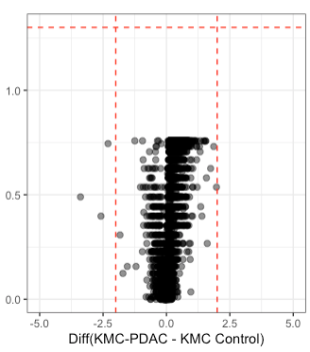
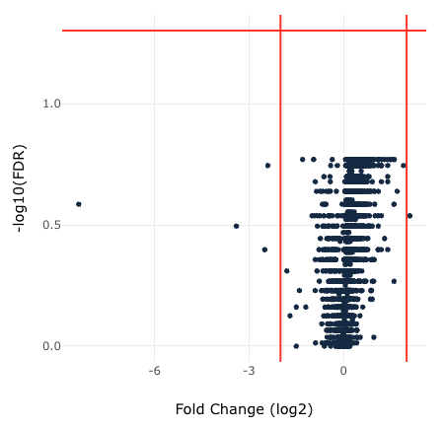
Milestone 2: Initial data analysis on SomaLogic outputs
DE: KMC-PDAC v. KMC Control
R Pipeline DE
SomaLogic DataDelve DE
-log10(pvalue)
Current R Pipeline Matches SomaLogic DataDelve DE Result

Slide 47
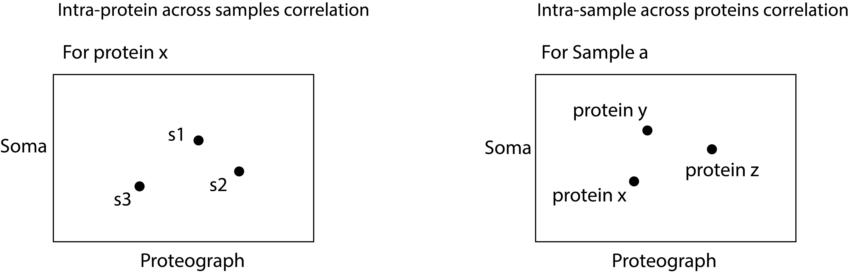
Milestone 4/7: Degree of agreement between quantitative outputs (Intensity correlation) for mouse samples
Seer MS and SomaLogic Assay Have Low Intensity Correlation for Mouse
Notes:
These violin boxplots show the same results from the last side, but across the entire murine KMC study arm.
These distributions reflect the correlation coefficients from multiple proteins across samples (left) and multiple samples across protein IDs (right).
Overall, we observe low correlation between the SomaLogic and Seer platforms, with most median correlation coefficients close to 0.
NEXT

Slide 48
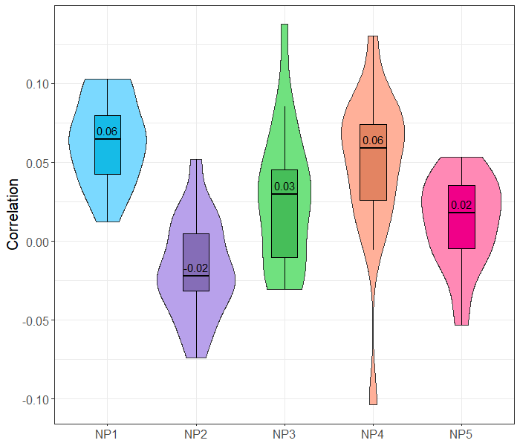
Milestone 4/7: Degree of agreement between quantitative outputs (Intensity correlation) for mouse samples
Intra-protein across samples correlation
Intra-sample across proteins correlation
Seer MS and SomaLogic Assay Have Low Intensity Correlation for Mouse
Notes:
These violin boxplots show the same results from the last side, but across the entire murine KMC study arm.
These distributions reflect the correlation coefficients from multiple proteins across samples (left) and multiple samples across protein IDs (right).
Overall, we observe low correlation between the SomaLogic and Seer platforms, with most median correlation coefficients close to 0.
NEXT

Slide 49
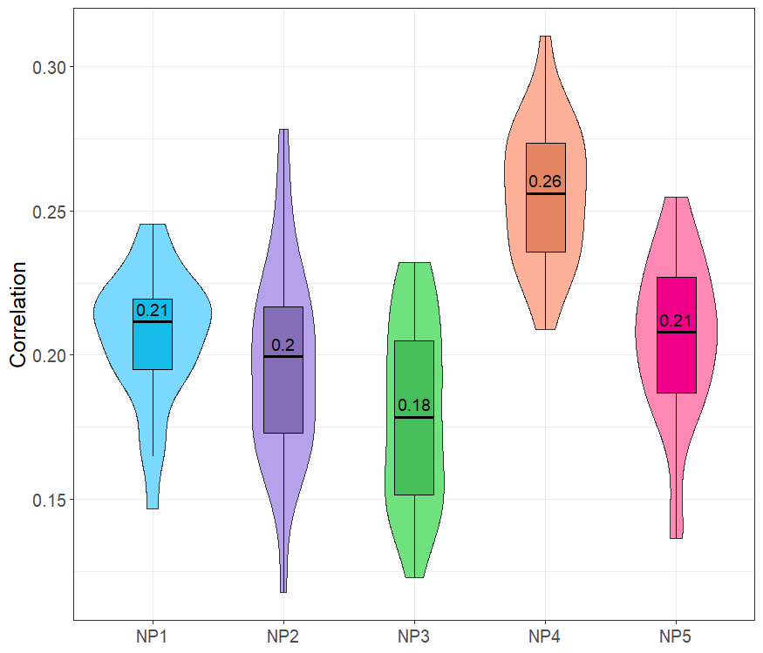
Milestone 4/7: Degree of agreement between quantitative outputs (Intensity correlation) for human samples
Intra-protein across samples correlation
Intra-sample across proteins correlation
Seer MS and SomaLogic Assay Have Low Intensity Correlation for Human
Notes:
Again, these violin boxplots show the same results from the last side, but across the entire human study.
On the left, distributions reflect the correlation coefficients from multiple proteins across samples. On the right, correlation coefficients from multiple samples across protein IDs.
Overall, we observe low, but slightly better correlation between the SomaLogic and Seer platforms with this human dataset, with most median correlation coefficients btwn 0.2-0.3.
NEXT

